Slide 1
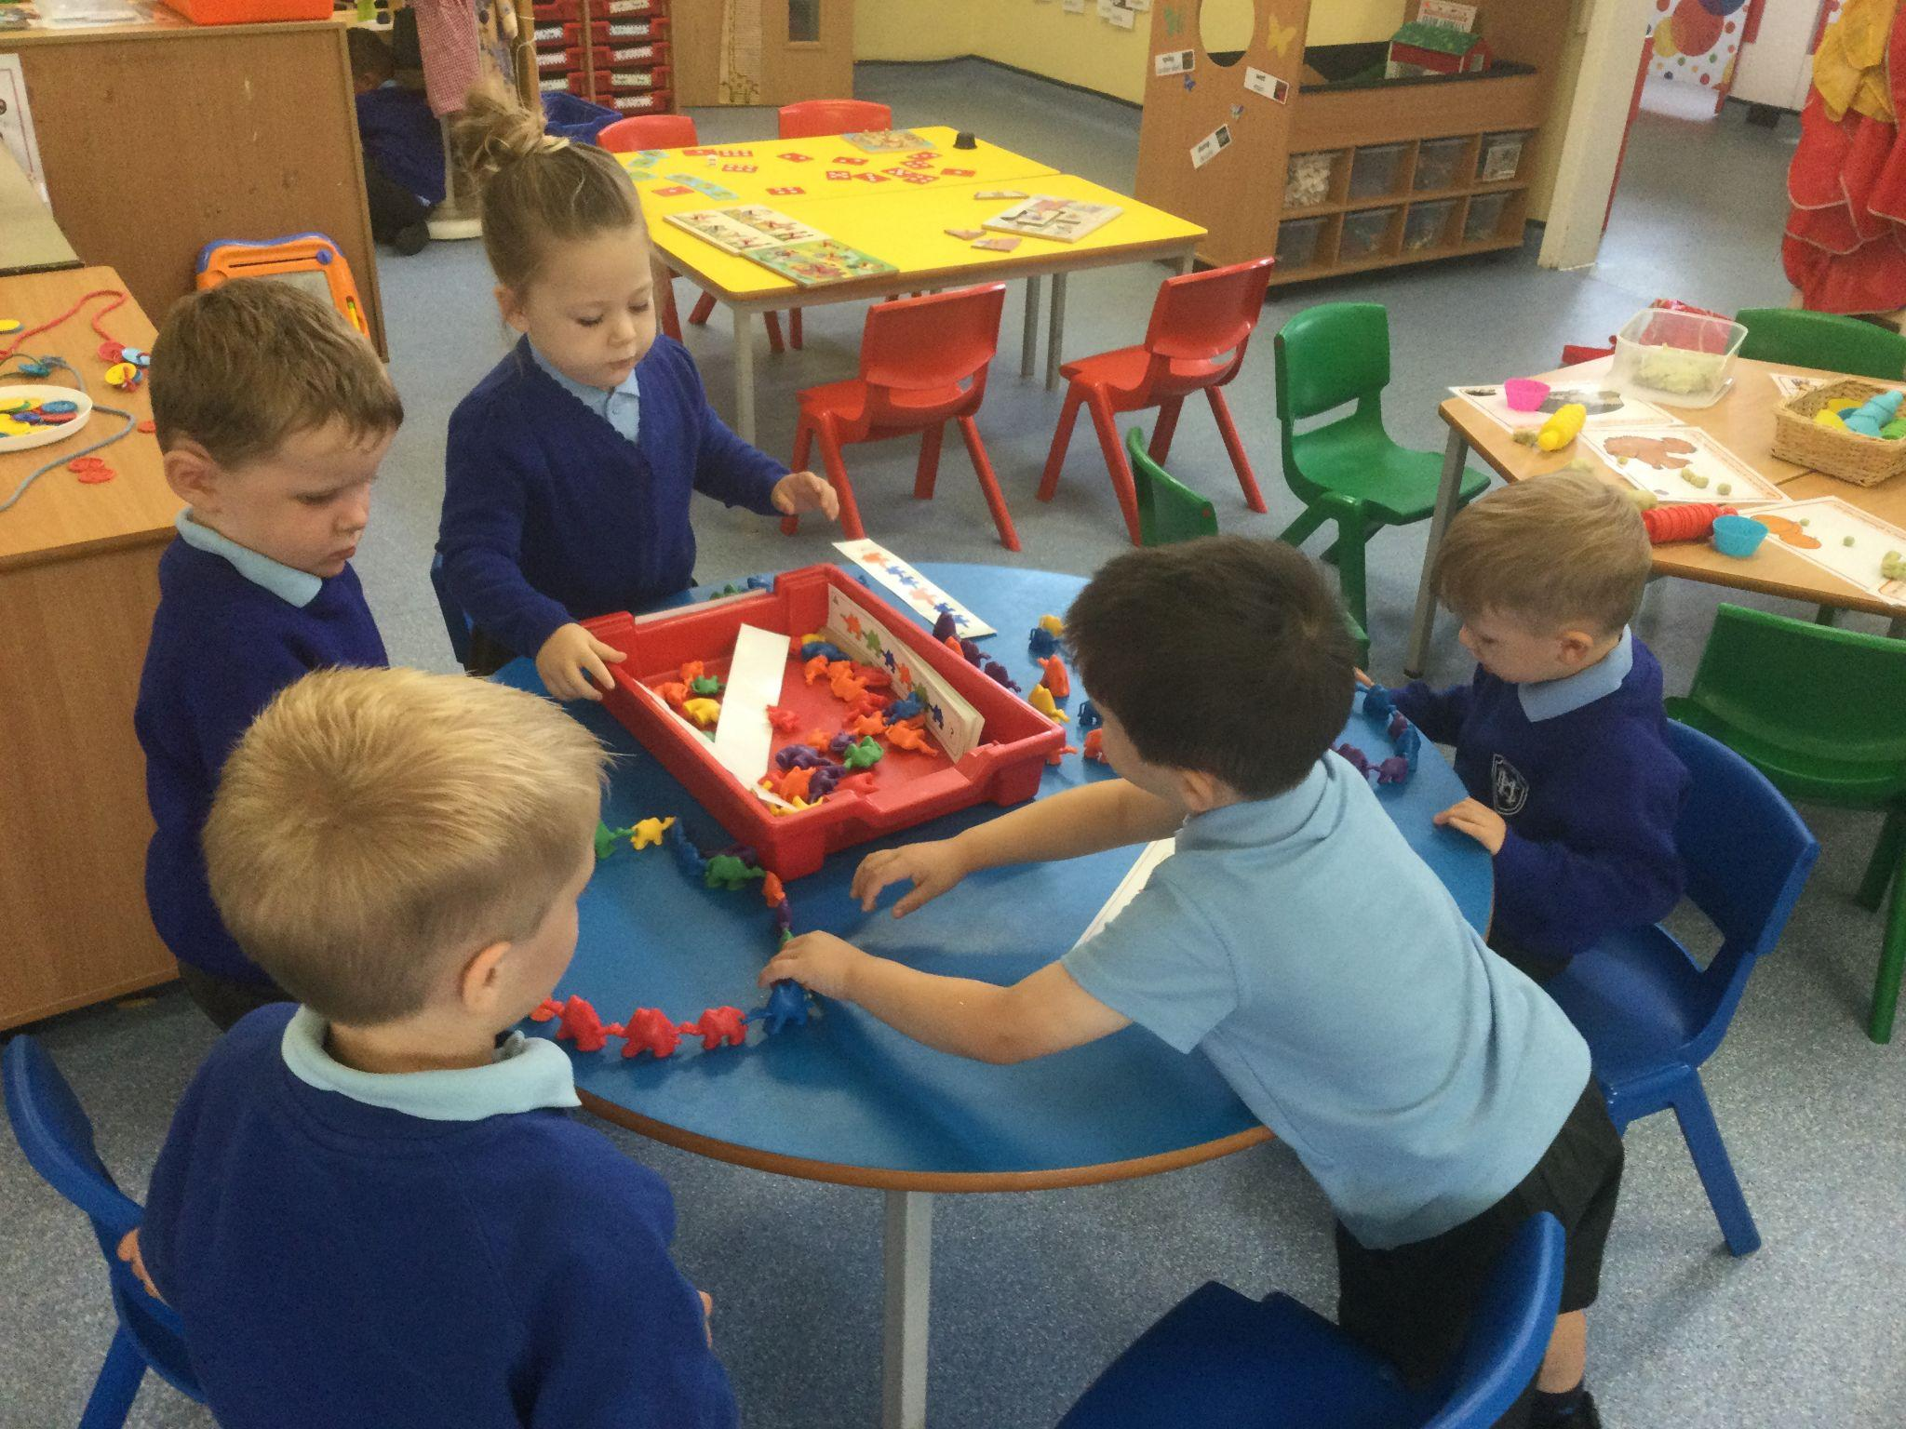
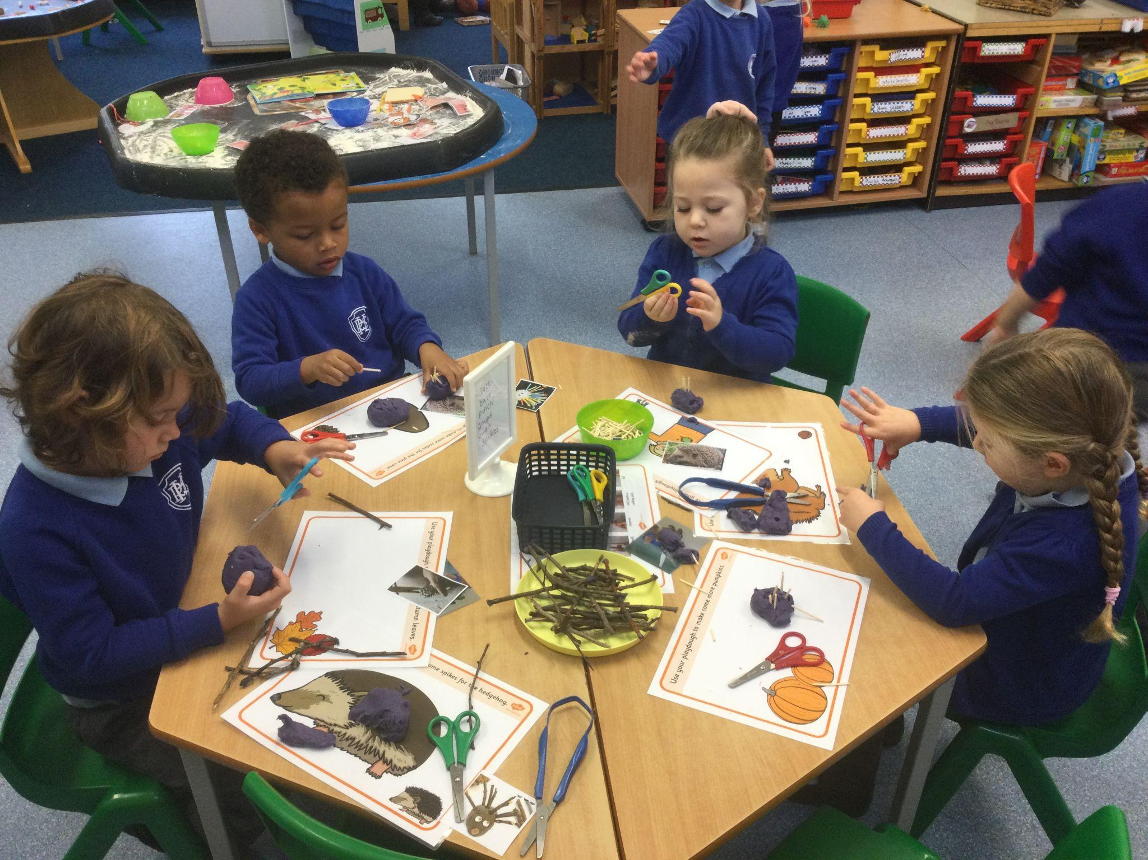
Nursery Induction Meeting for Parents
2023 Entry

Slide 2
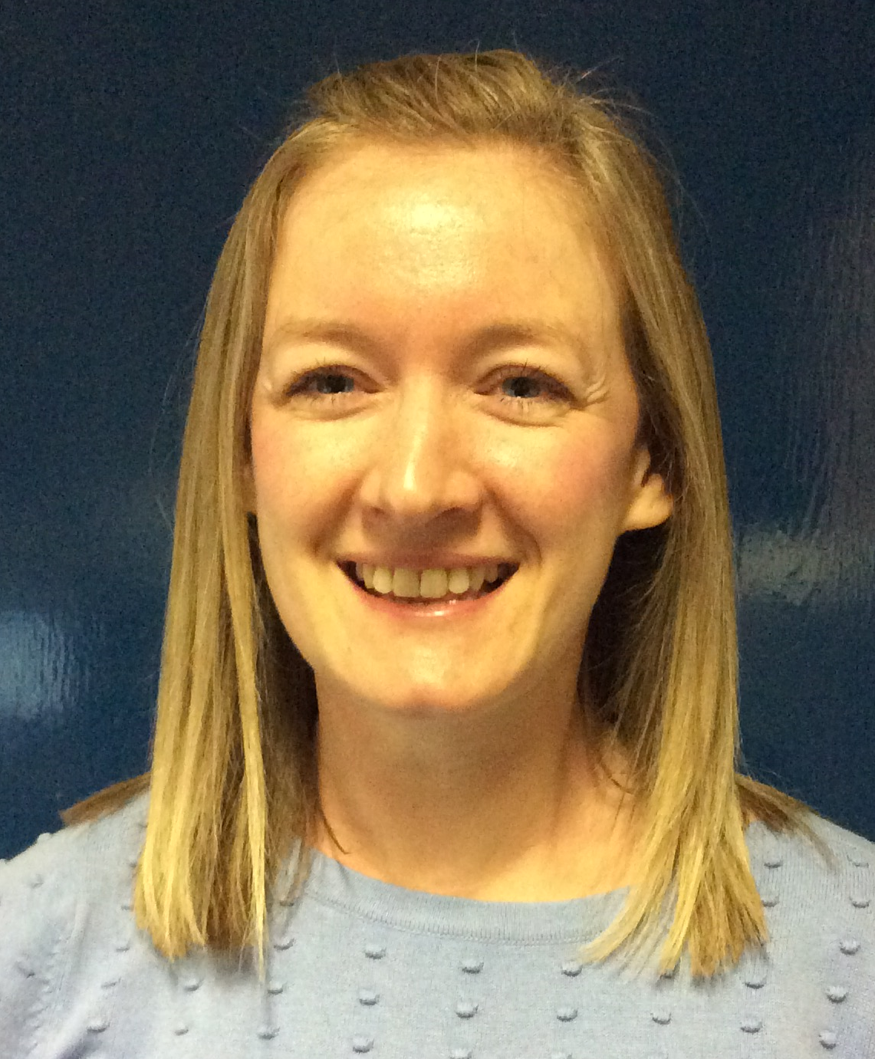
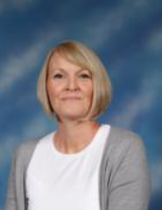
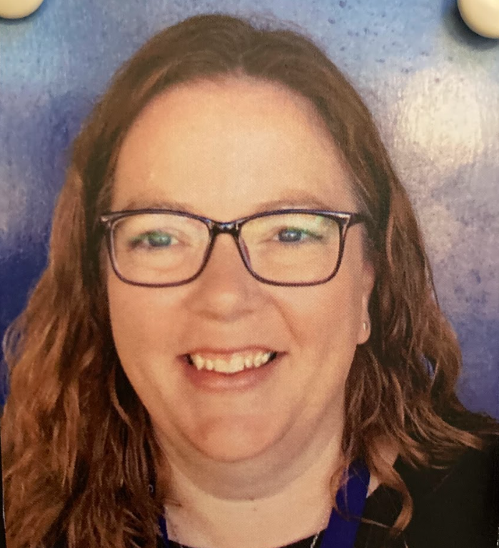
Meet the Nursery Team
Miss Barnard
Nursery Teacher
Mrs Paternoster
EYP Mornings
Mrs Brinkley
EYP Afternoons

Slide 3
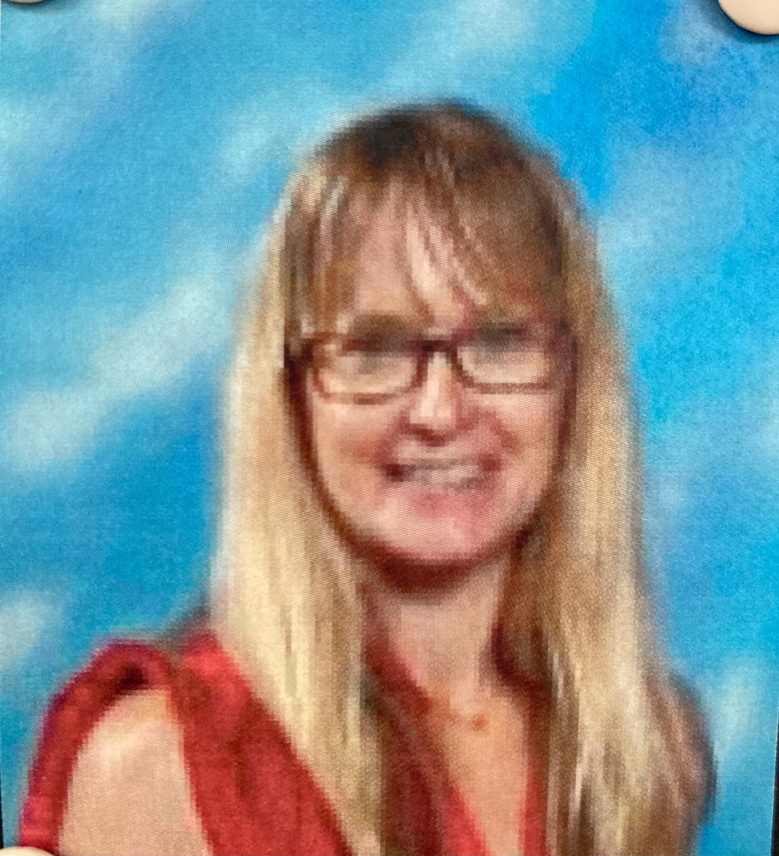
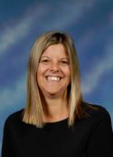
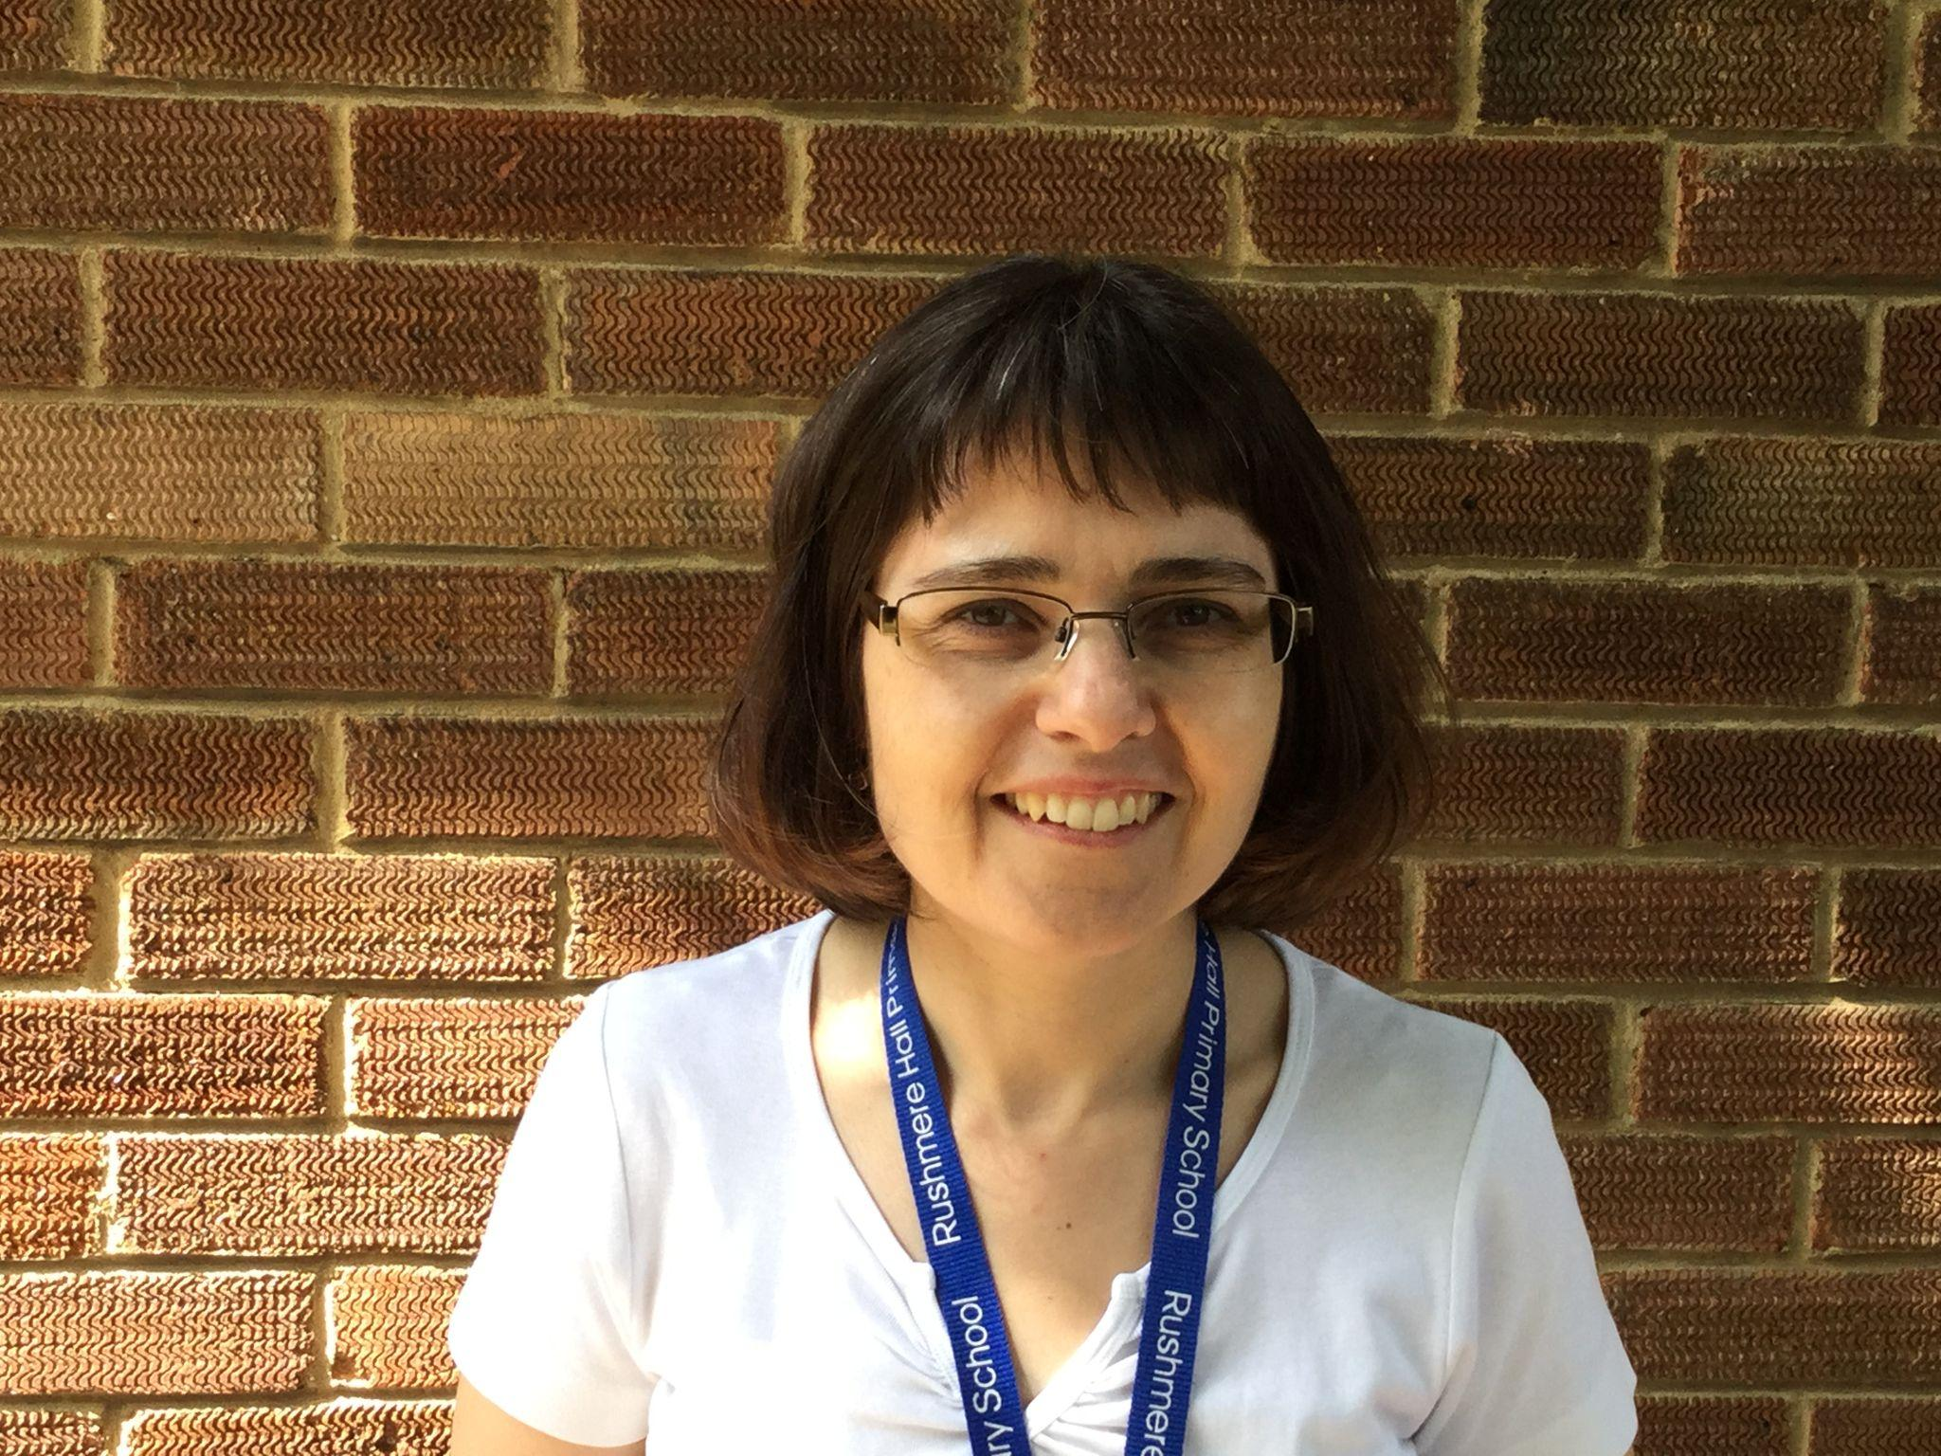
Other adults who help
Mrs Cook
Mrs White
Speech and Language
Mrs Mills

Slide 4
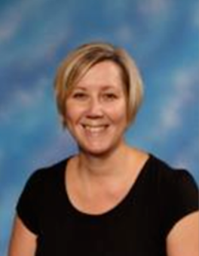
EYFS Phase Leader
Mrs Dunne
Reception class teacher and EYFS Phase Leader

Slide 5
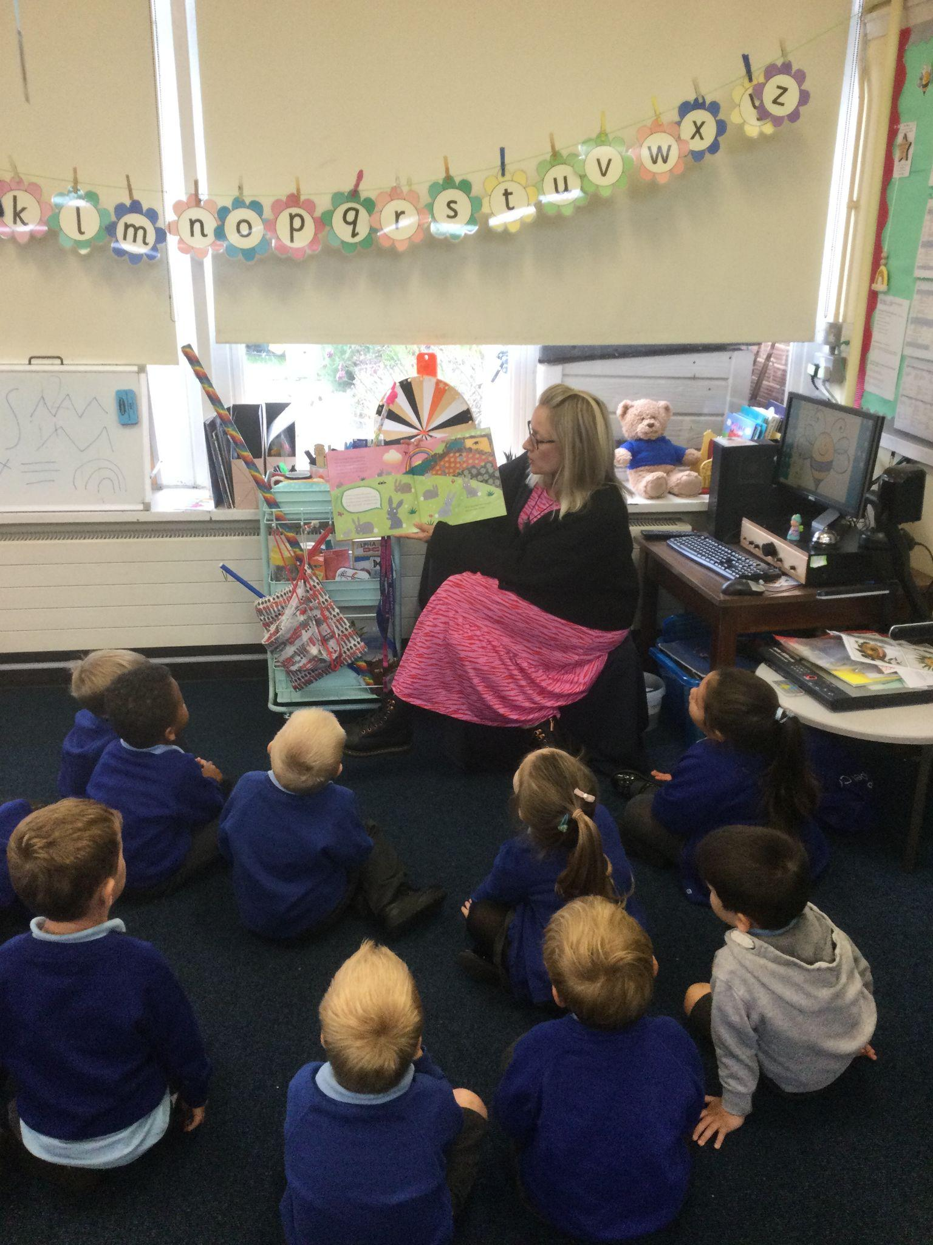
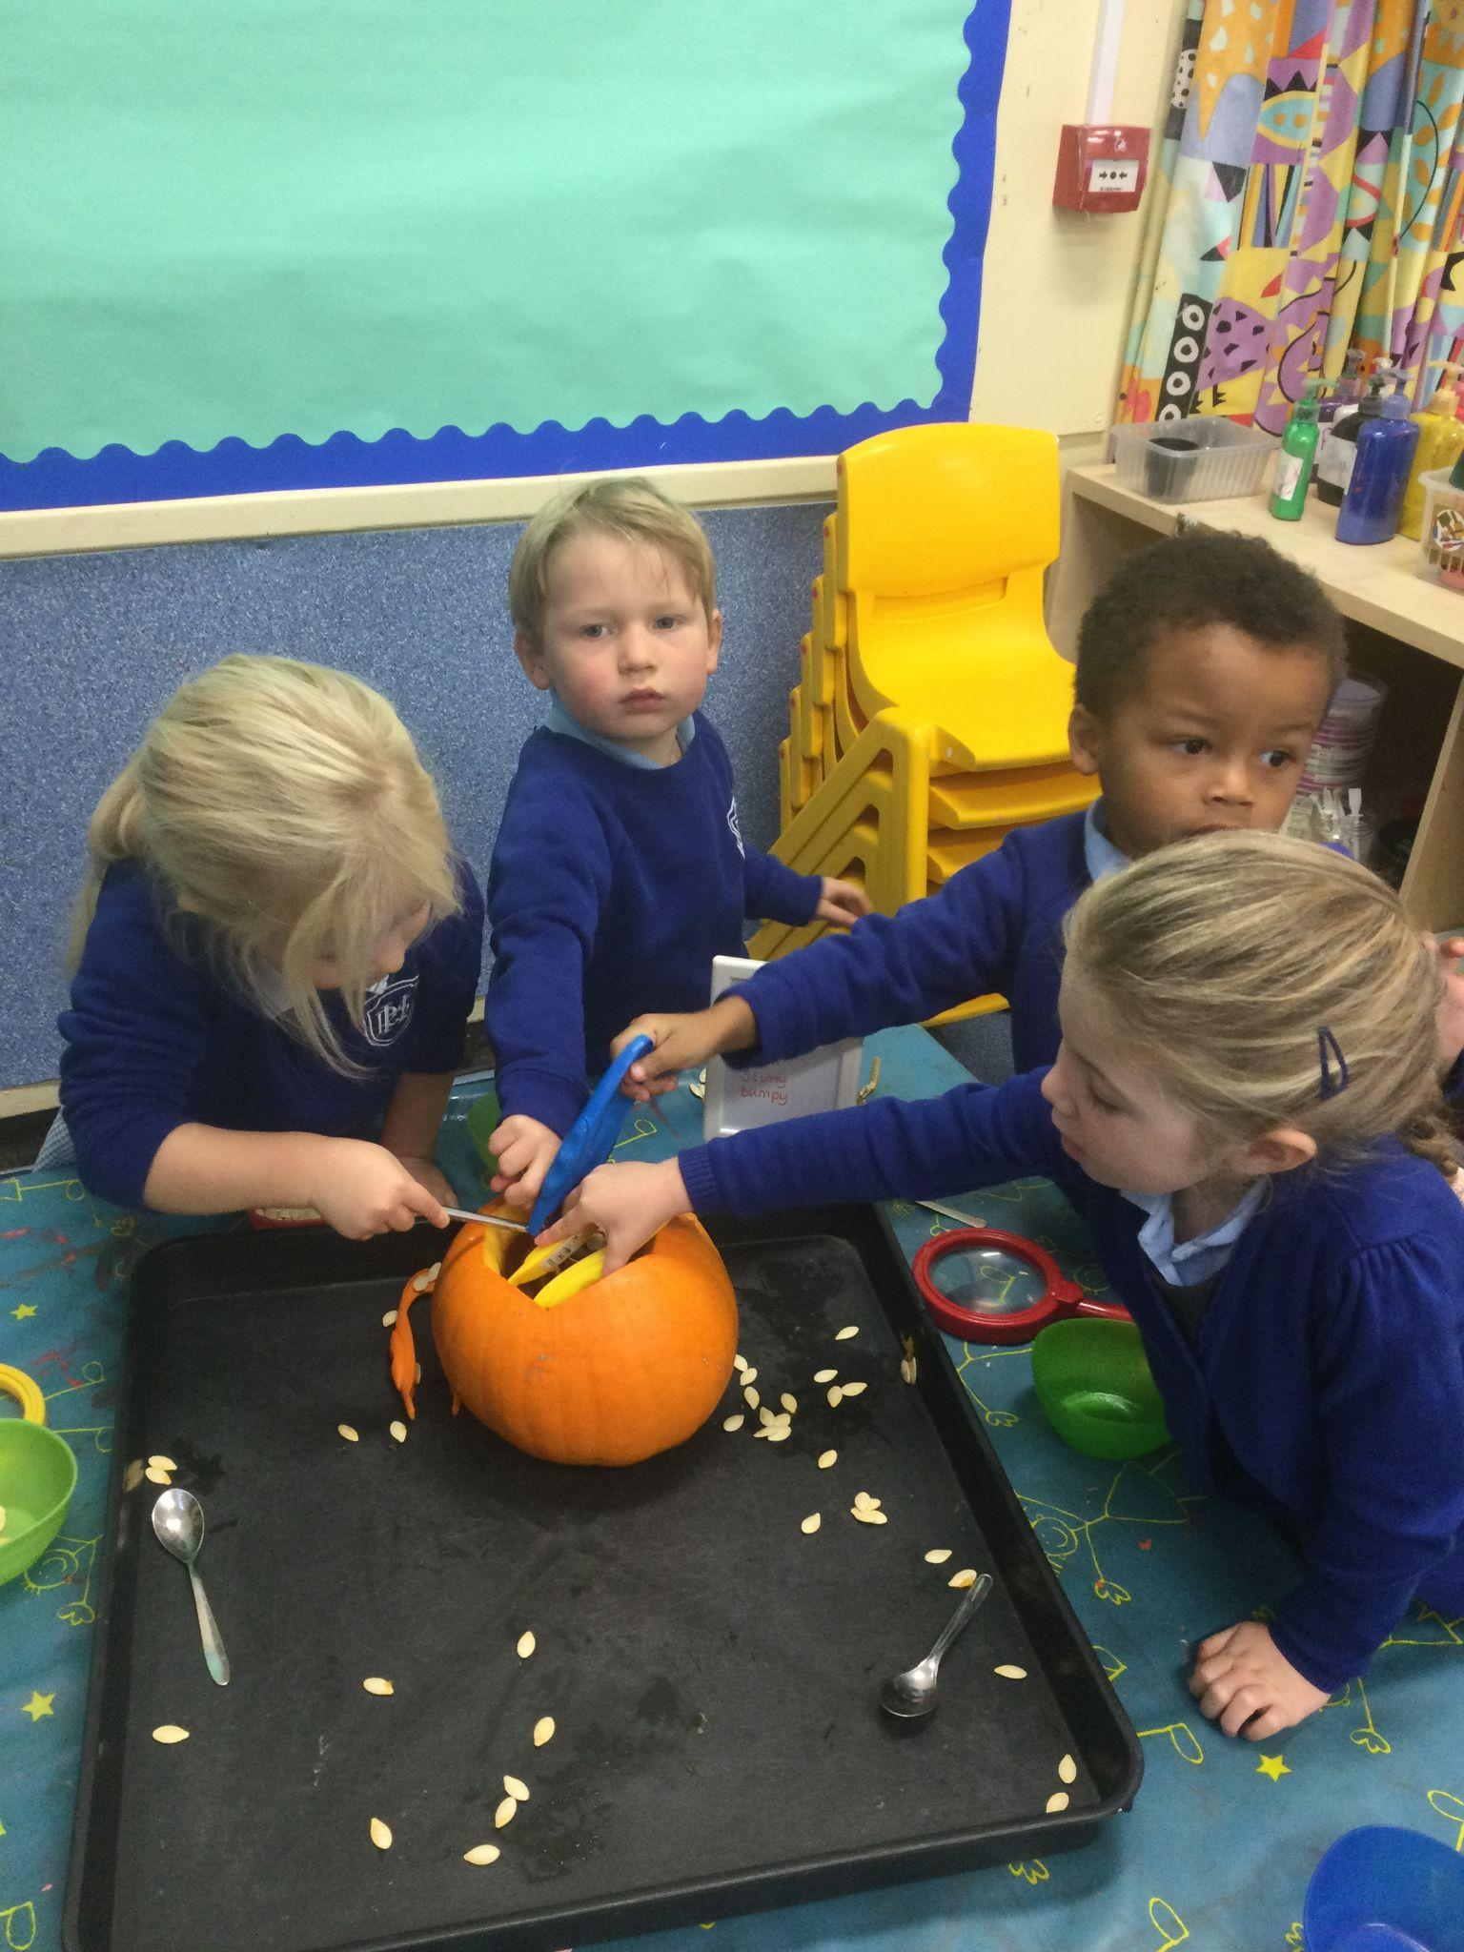
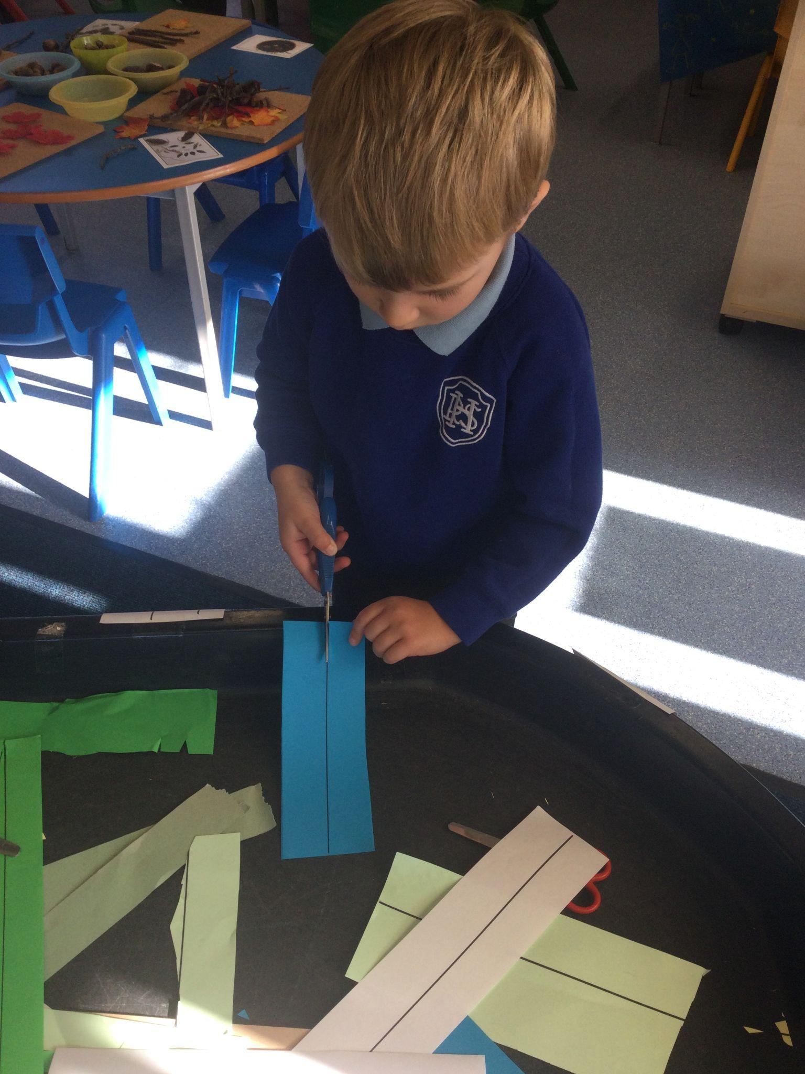
Our Curriculum

Slide 6
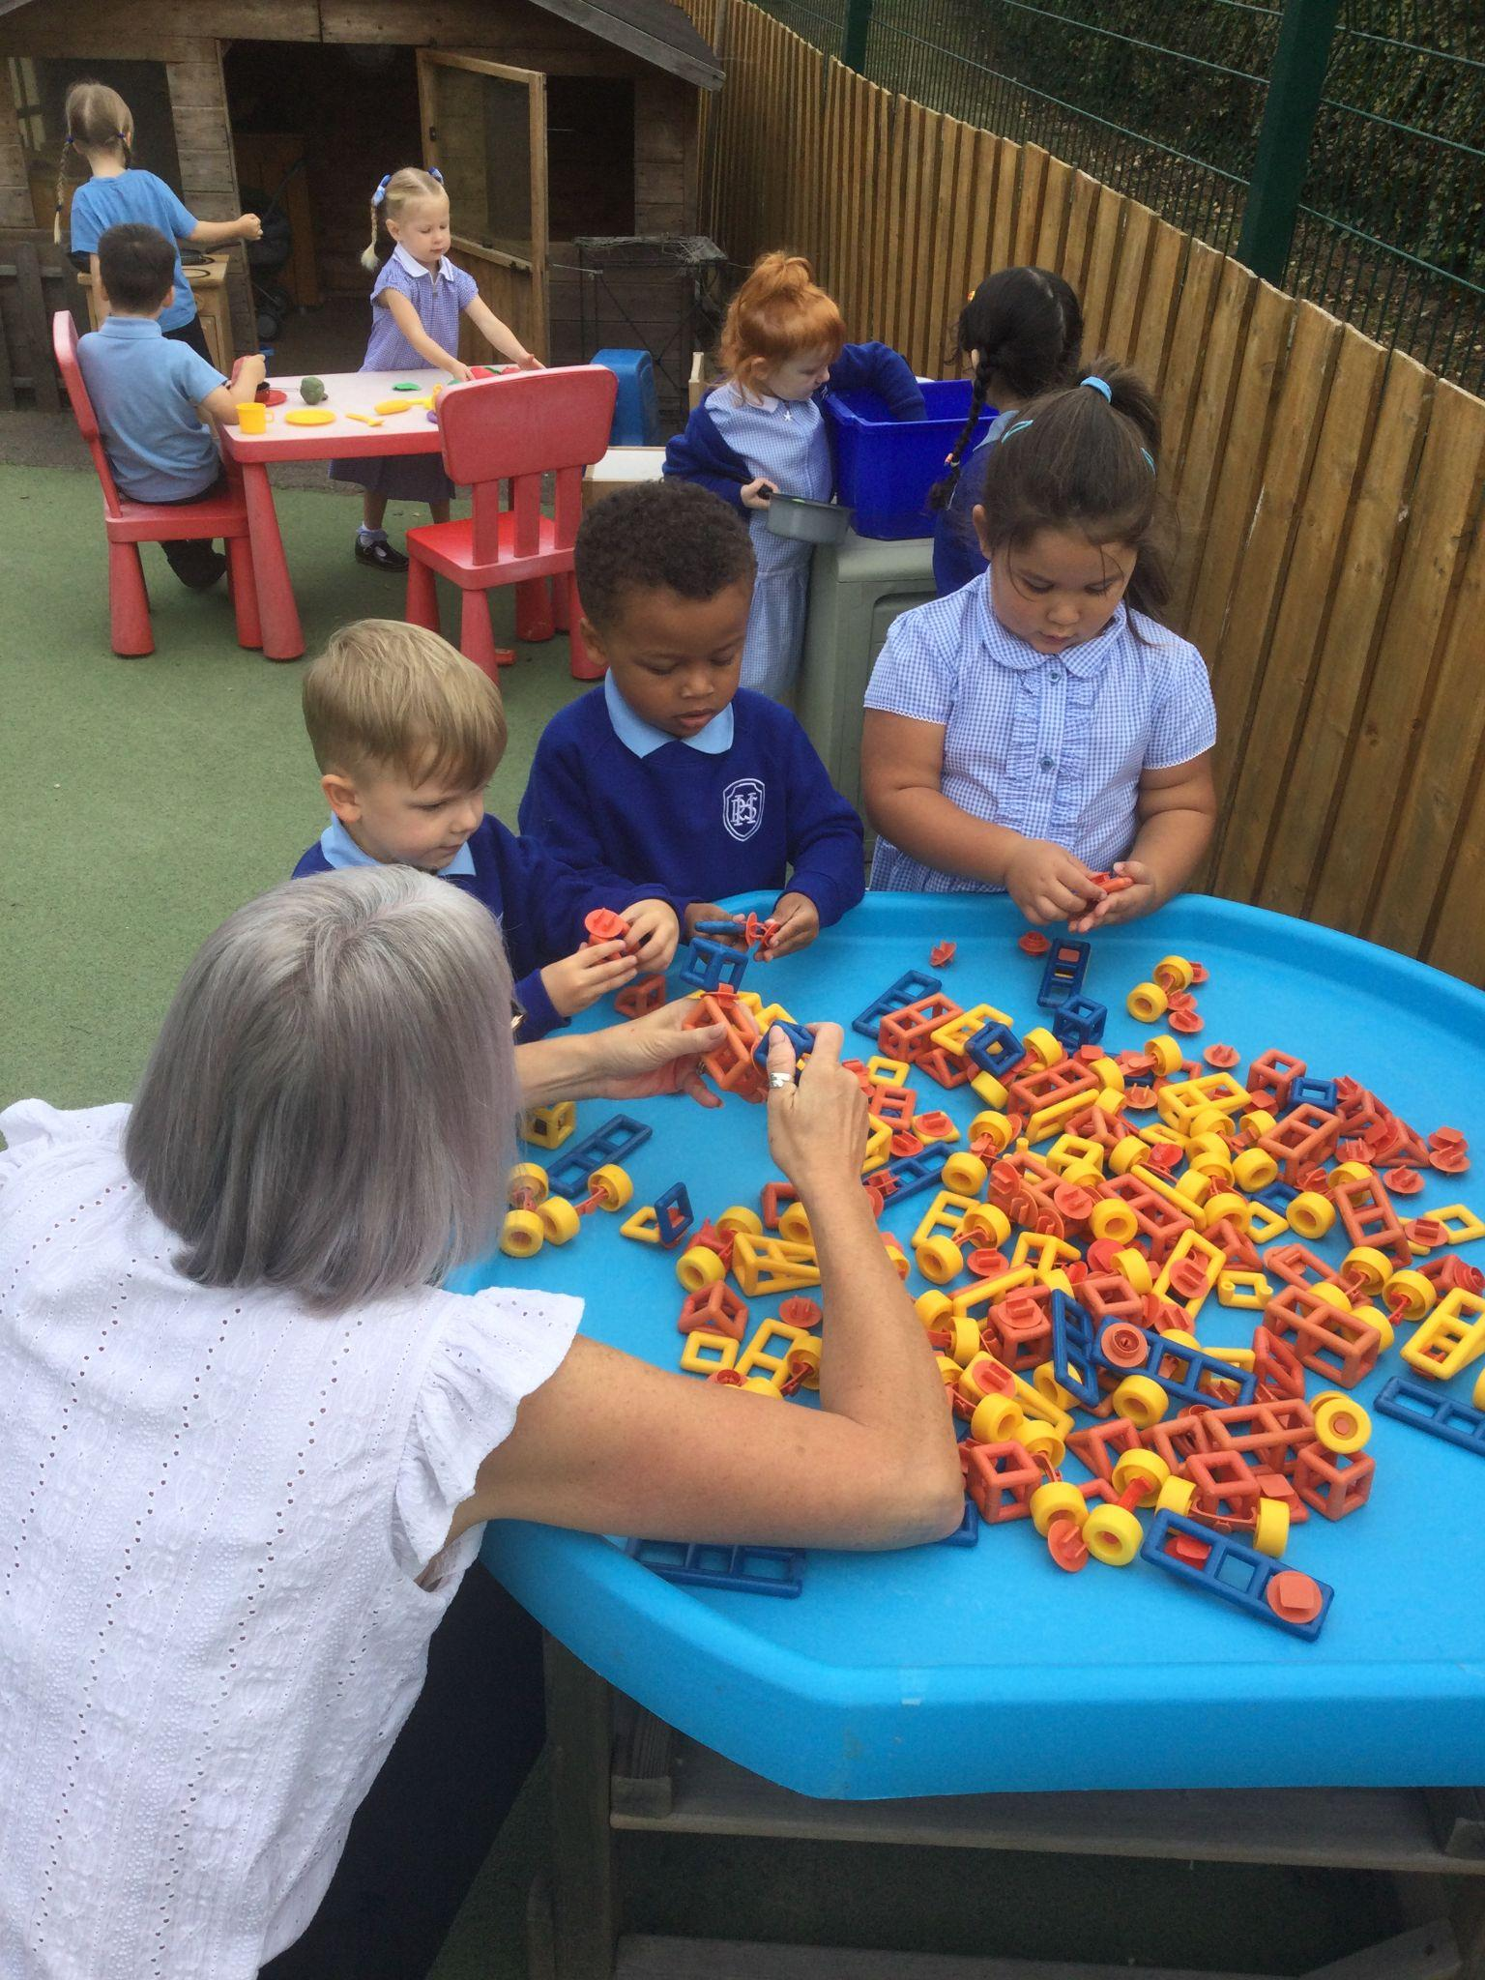
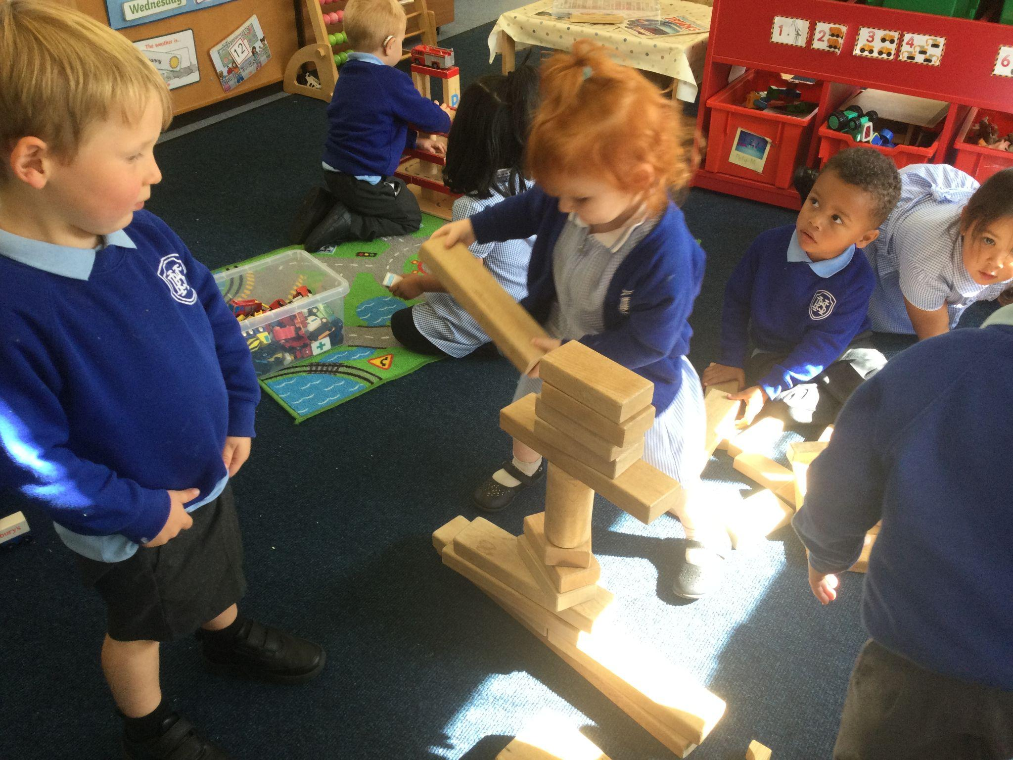
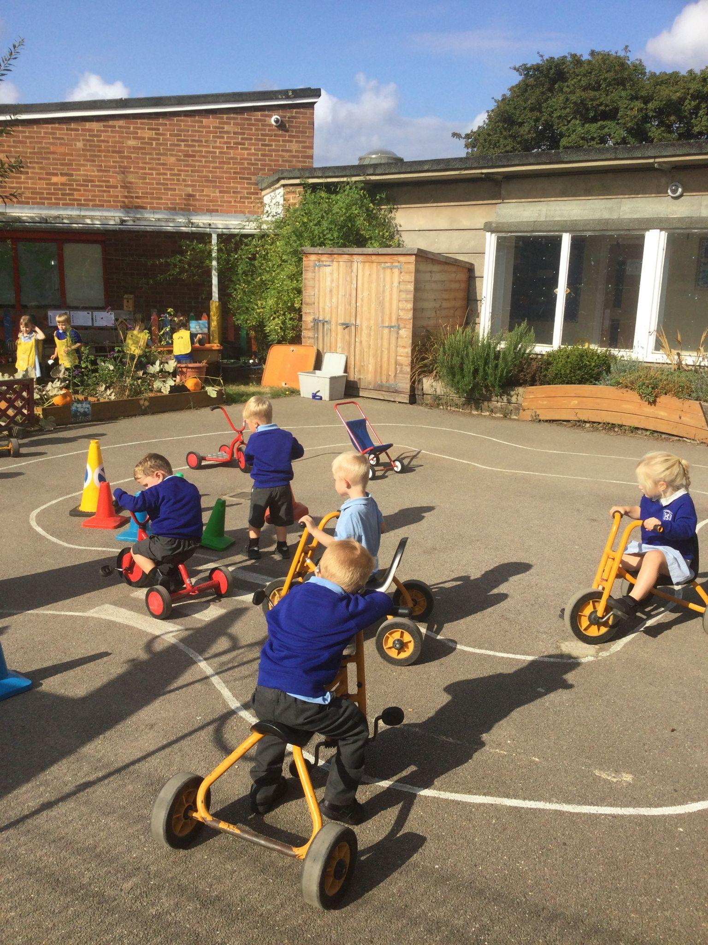
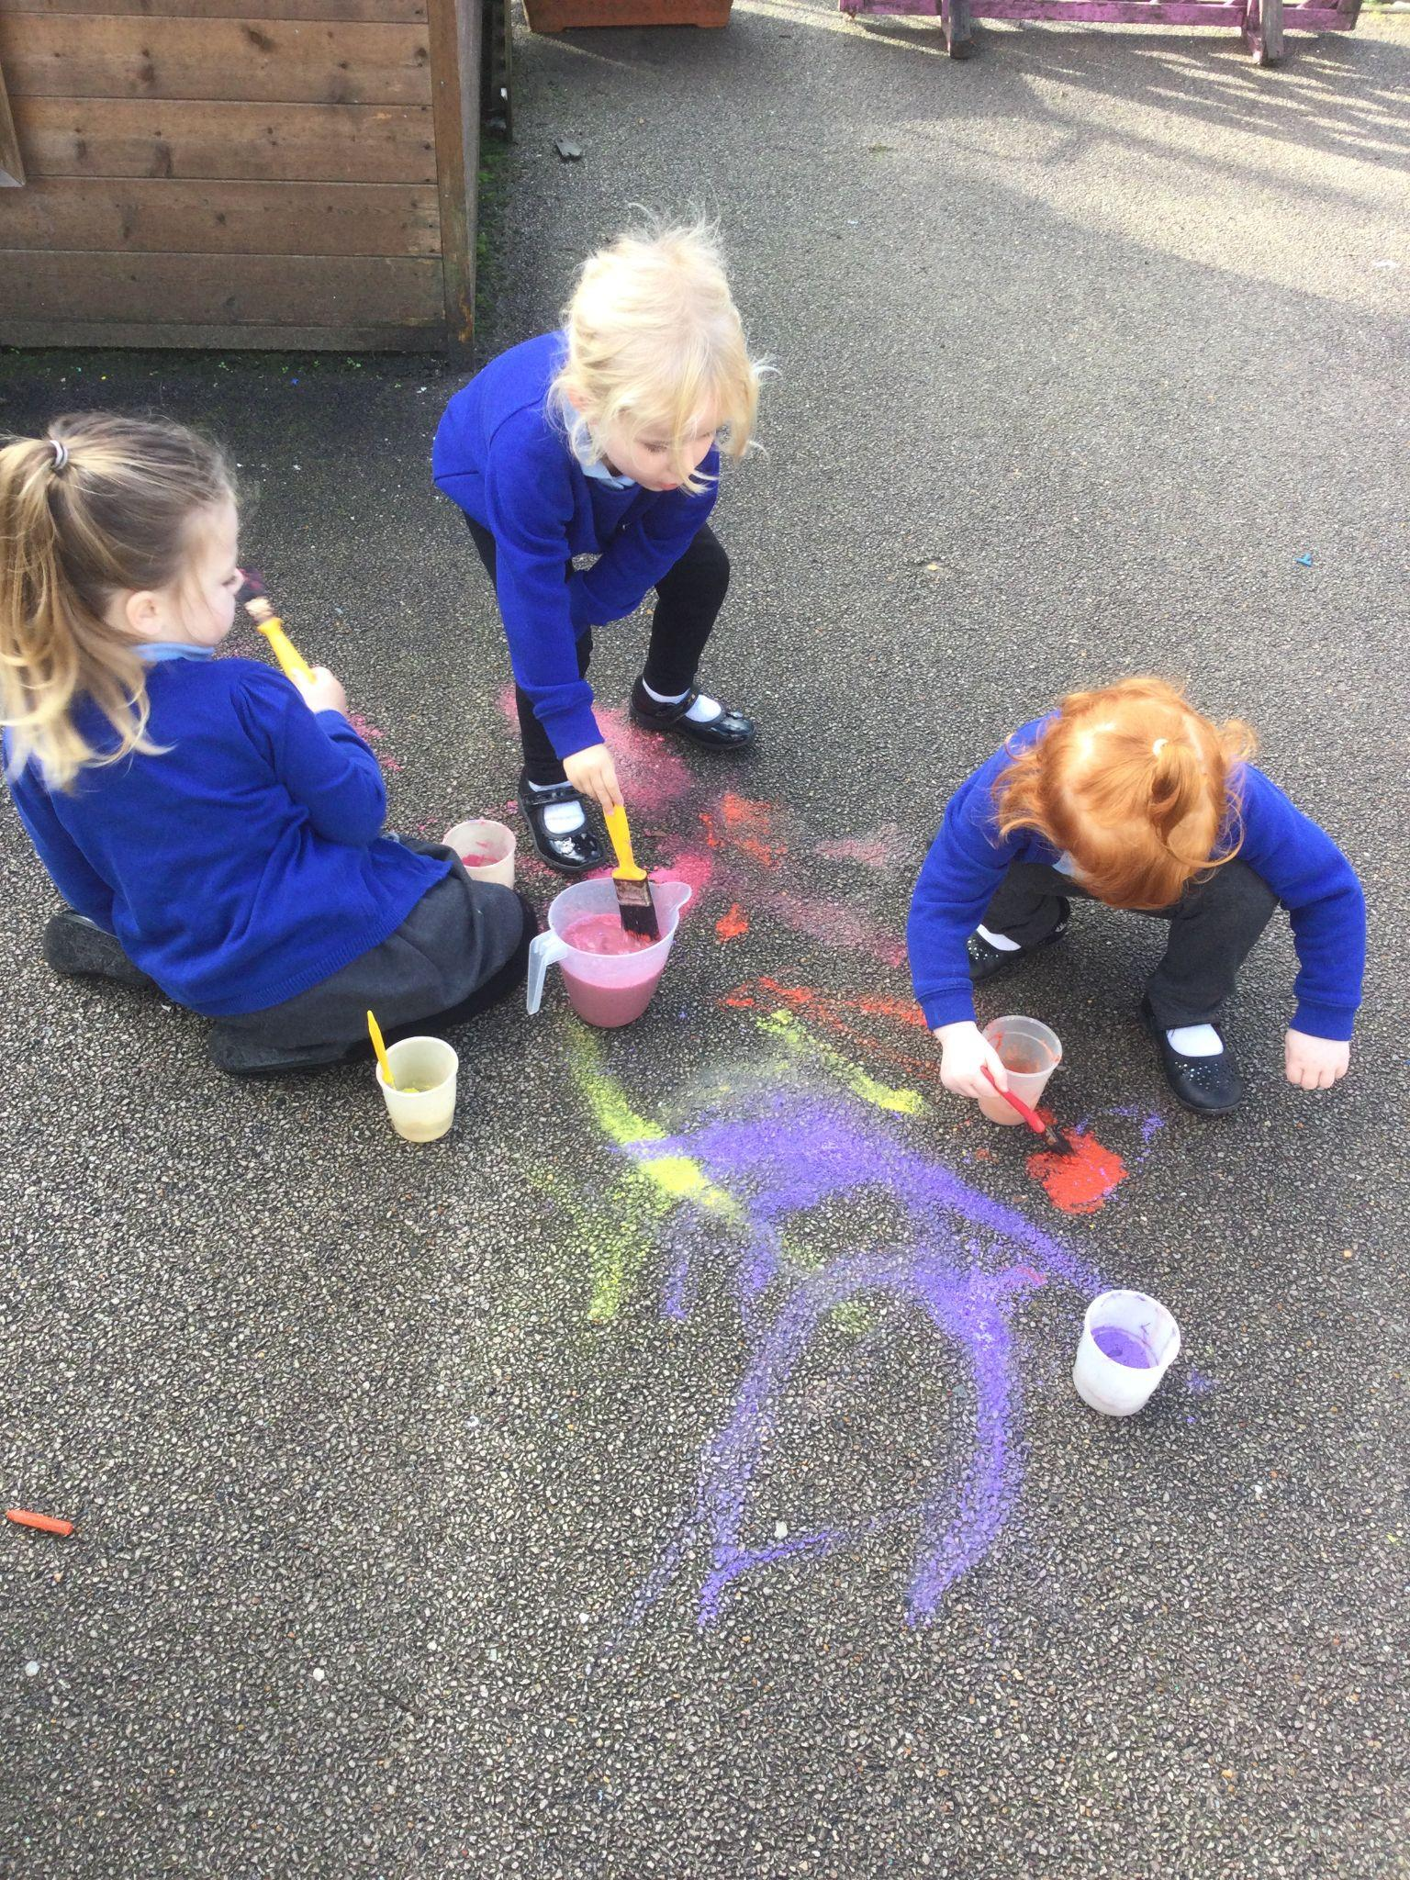
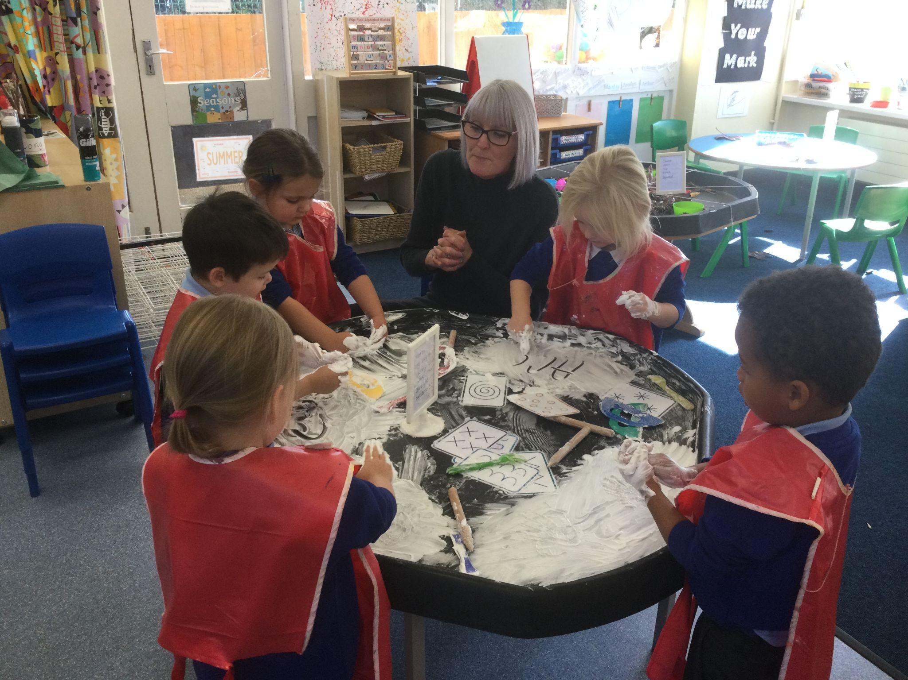
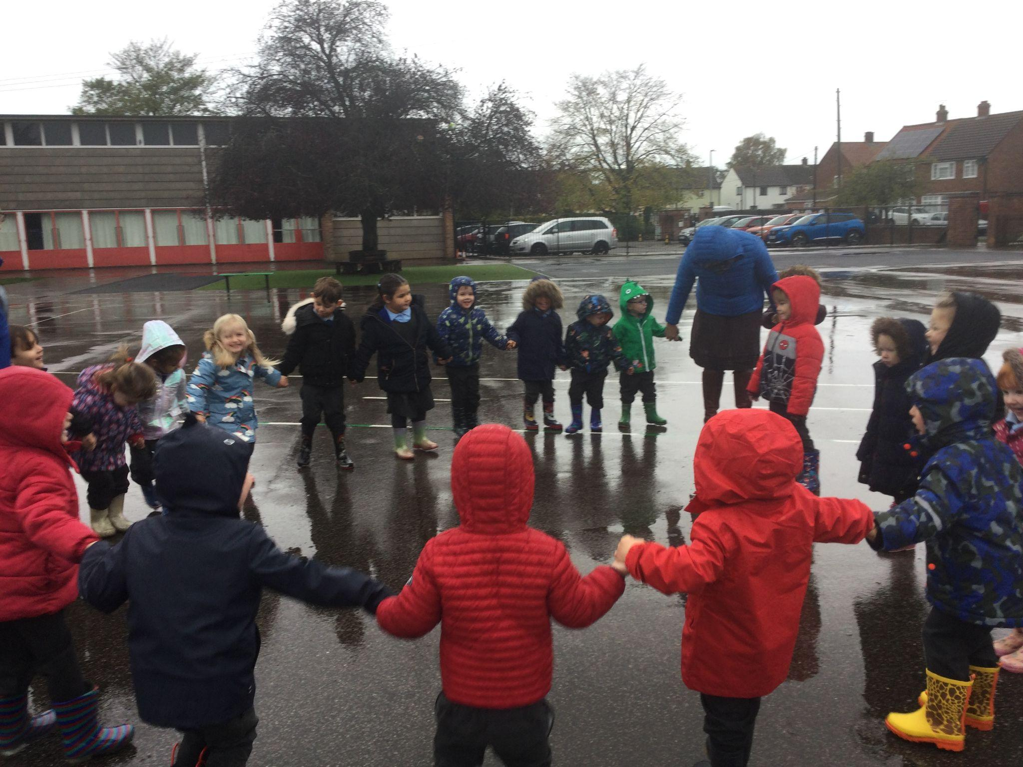

Slide 7
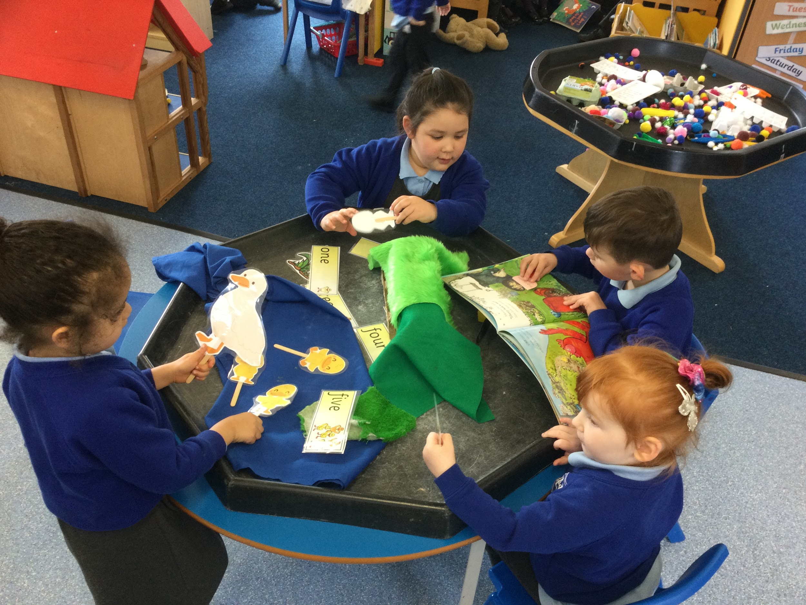
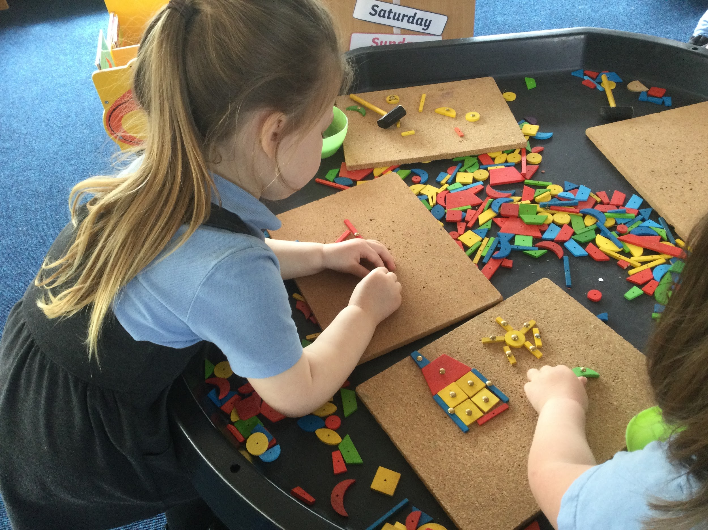
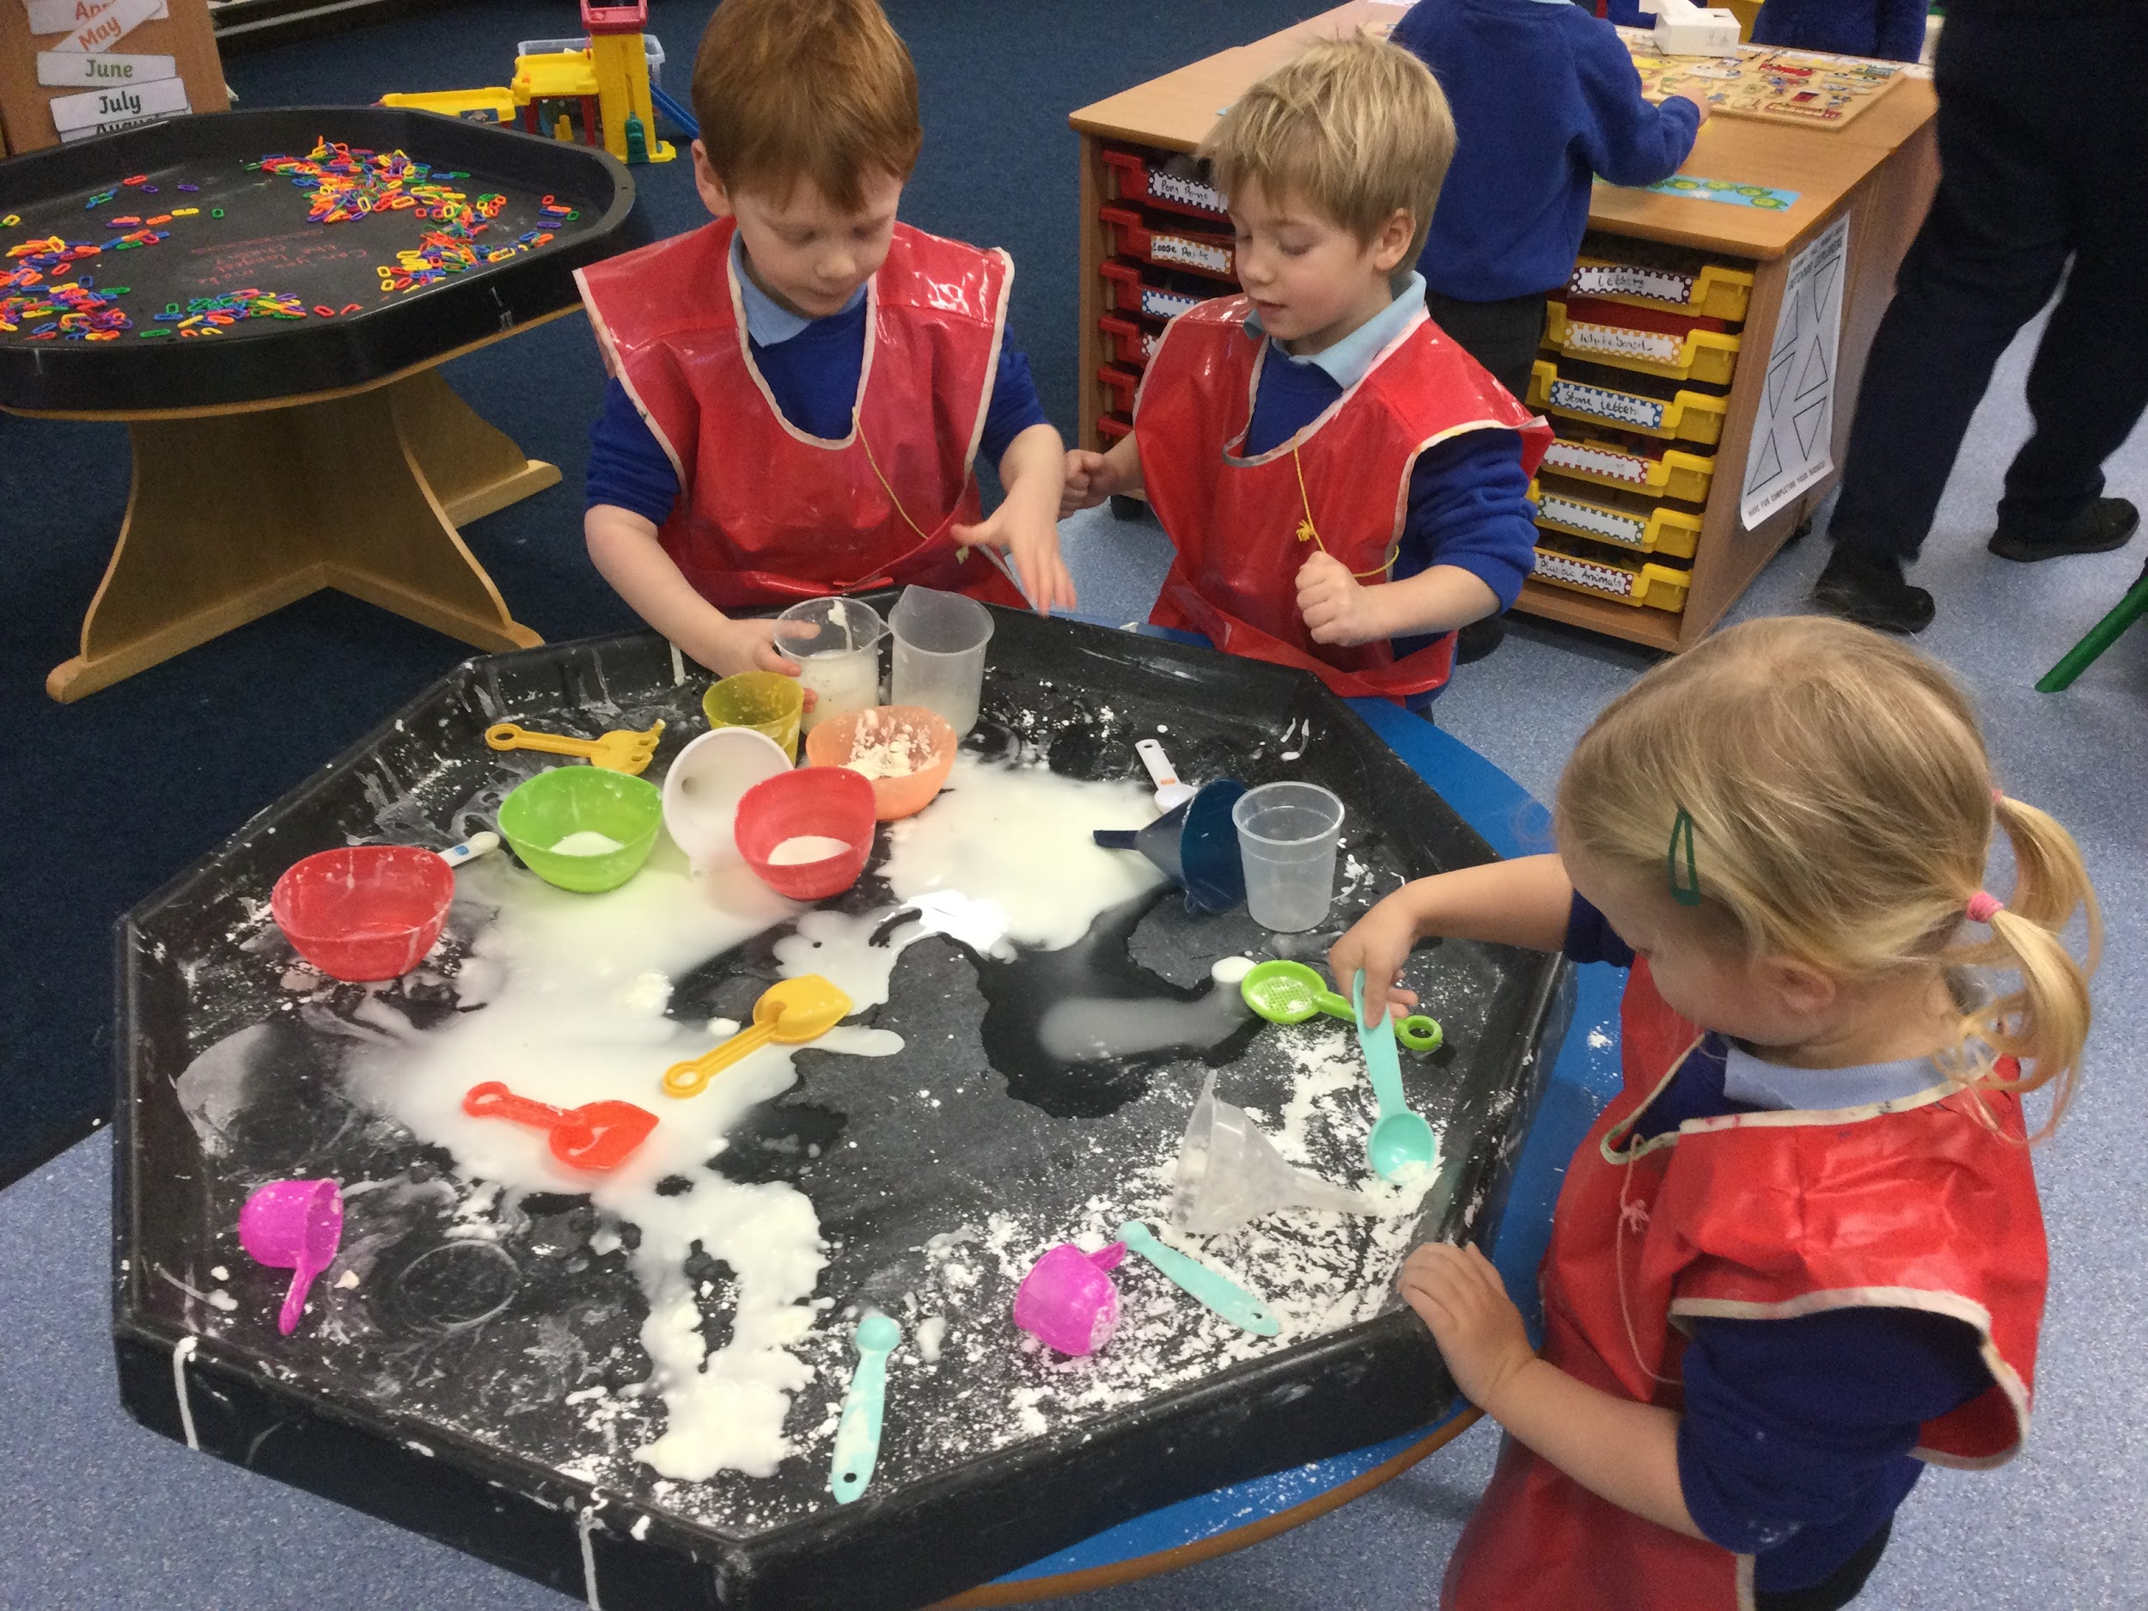
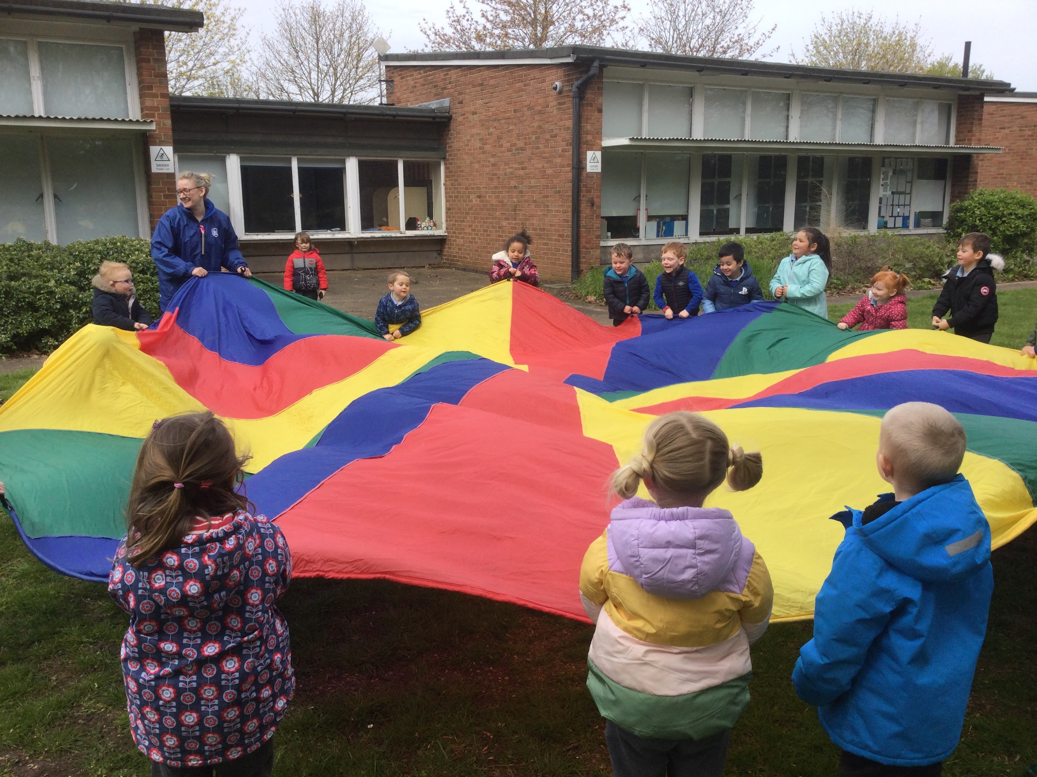
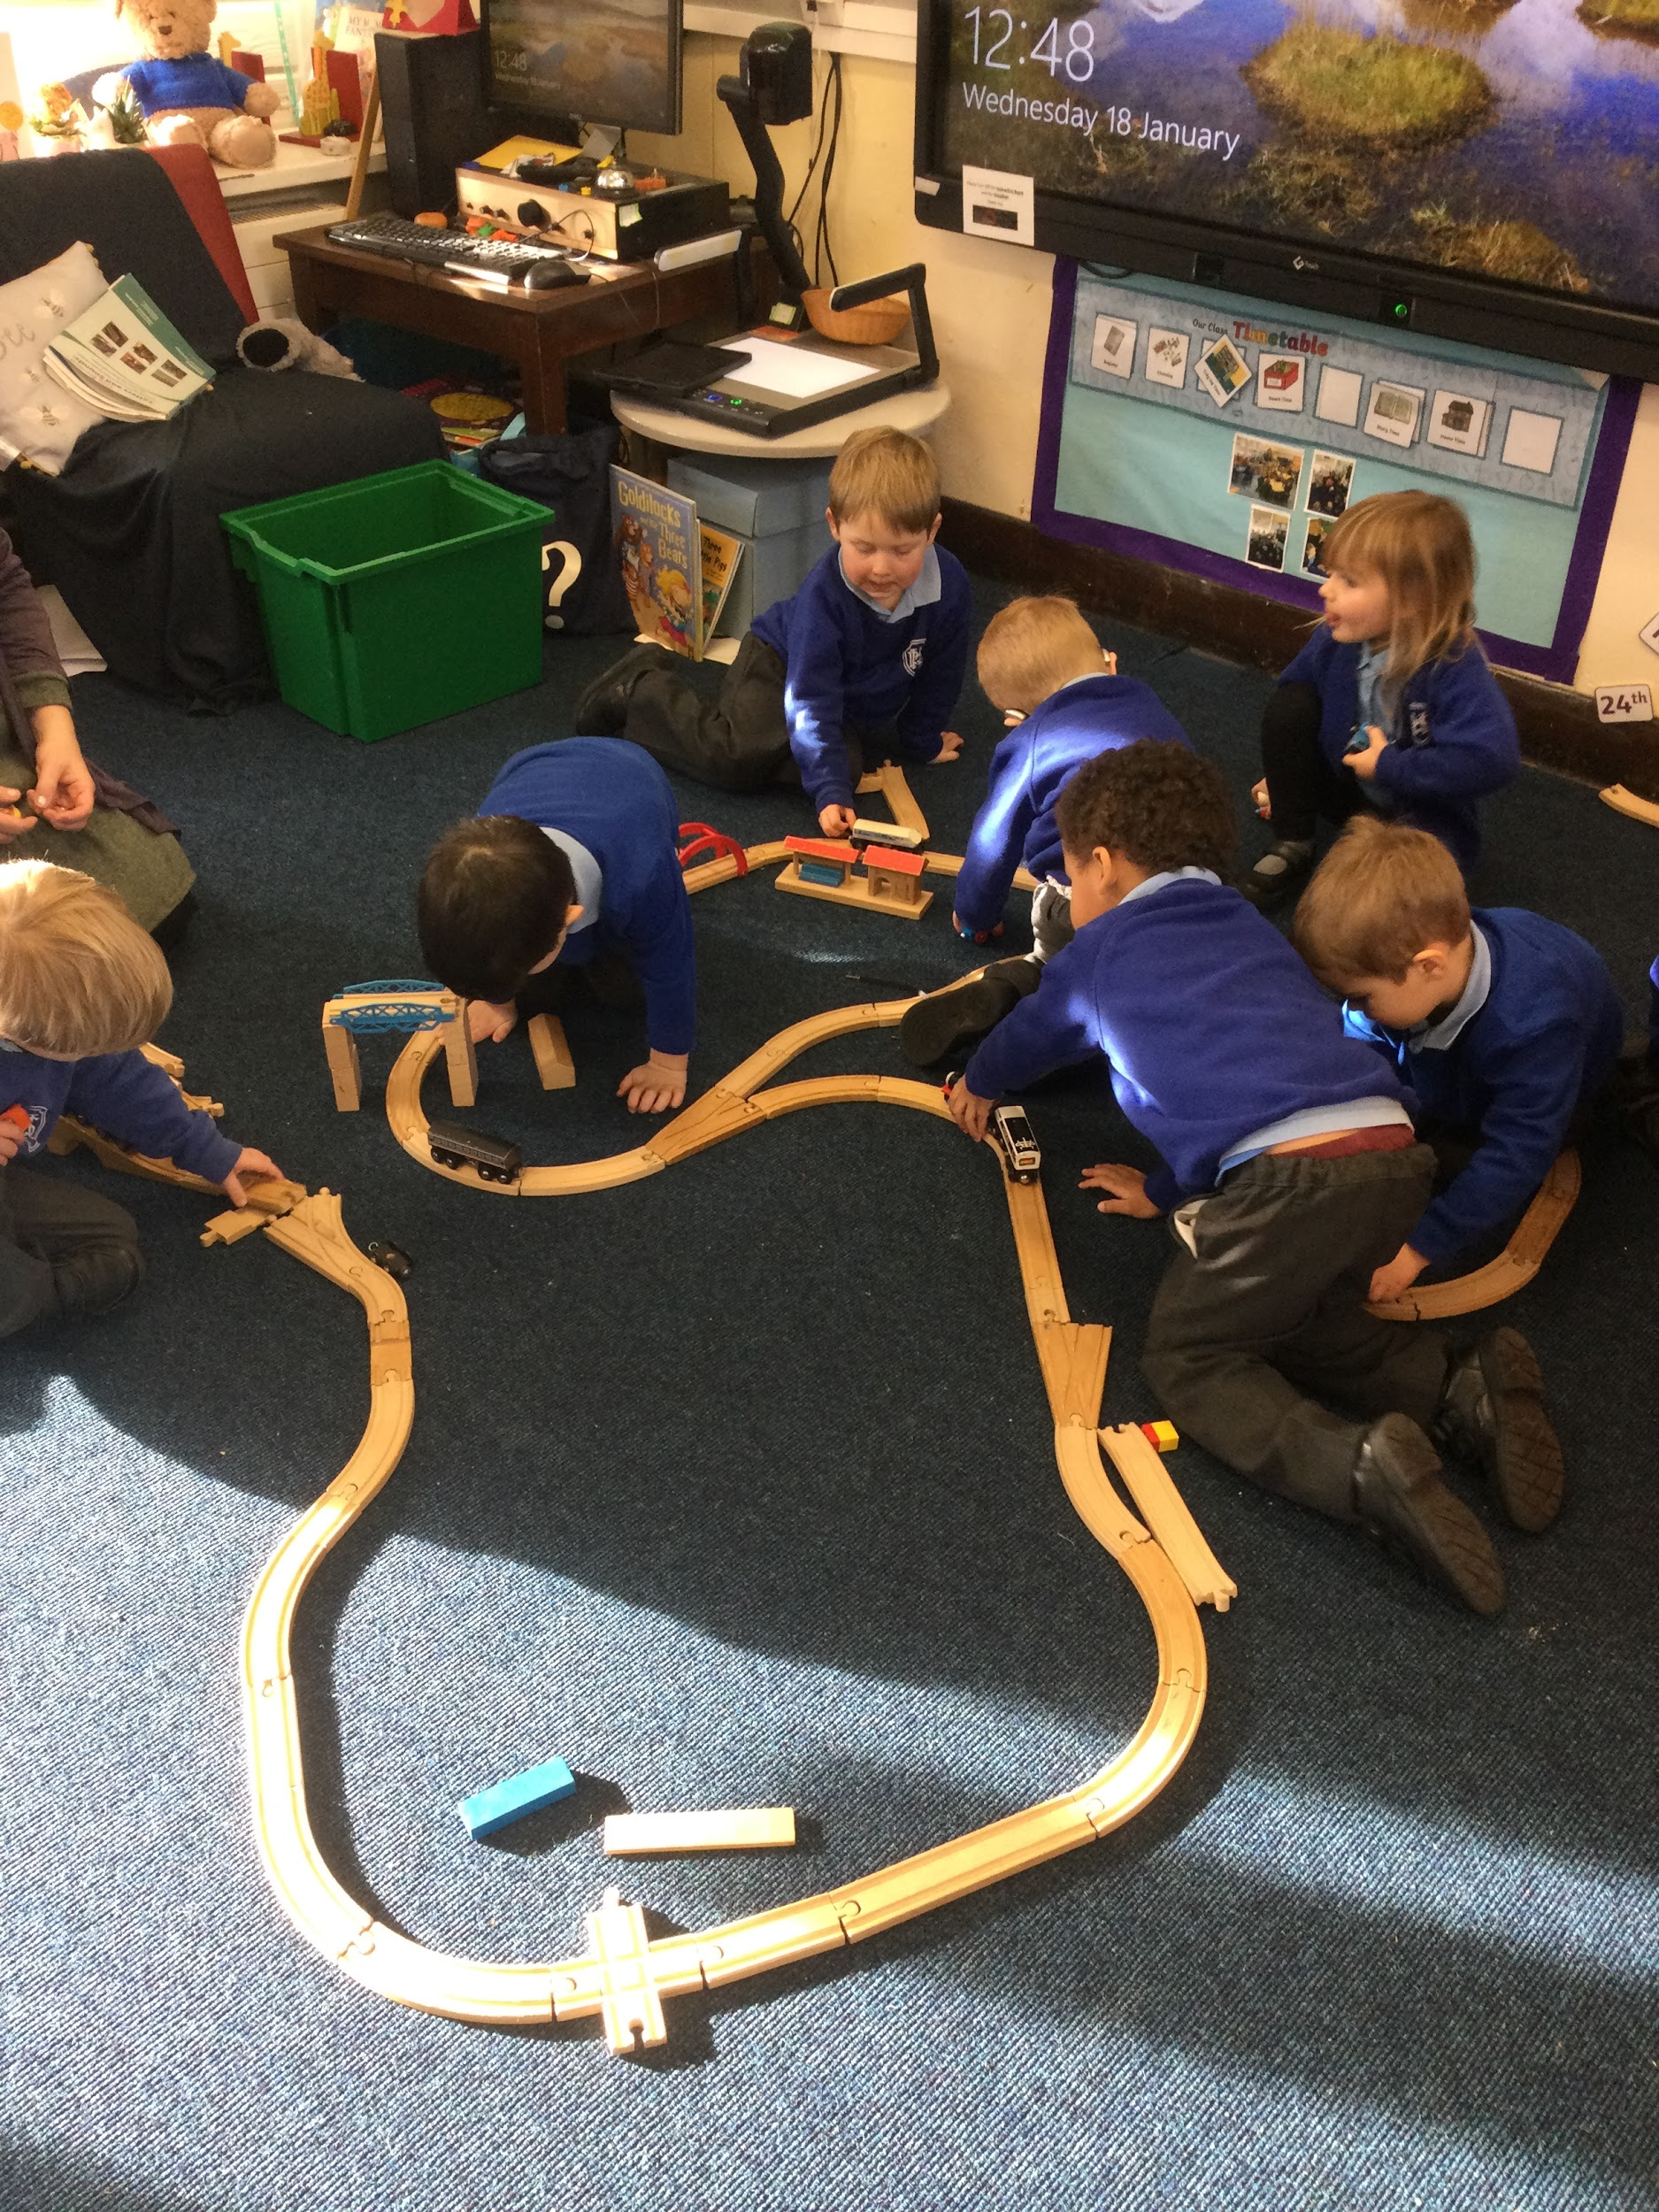
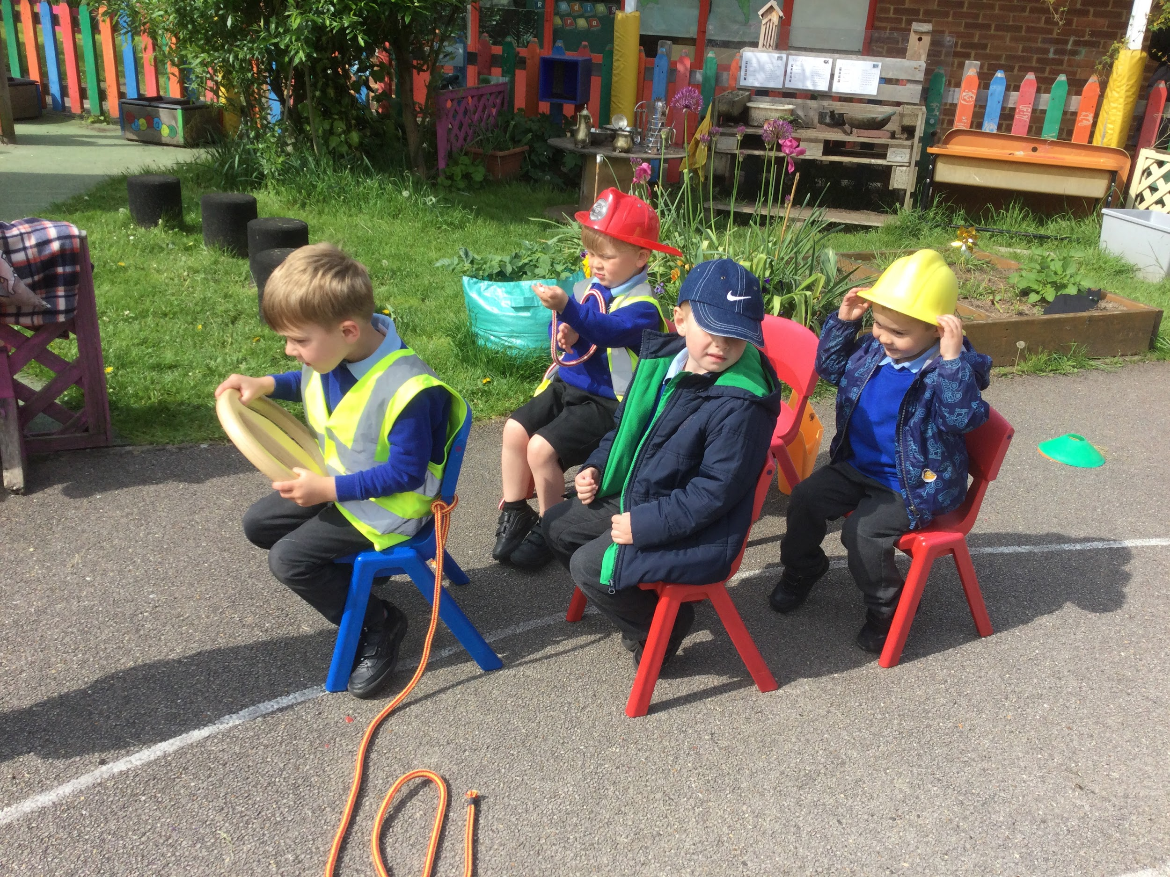
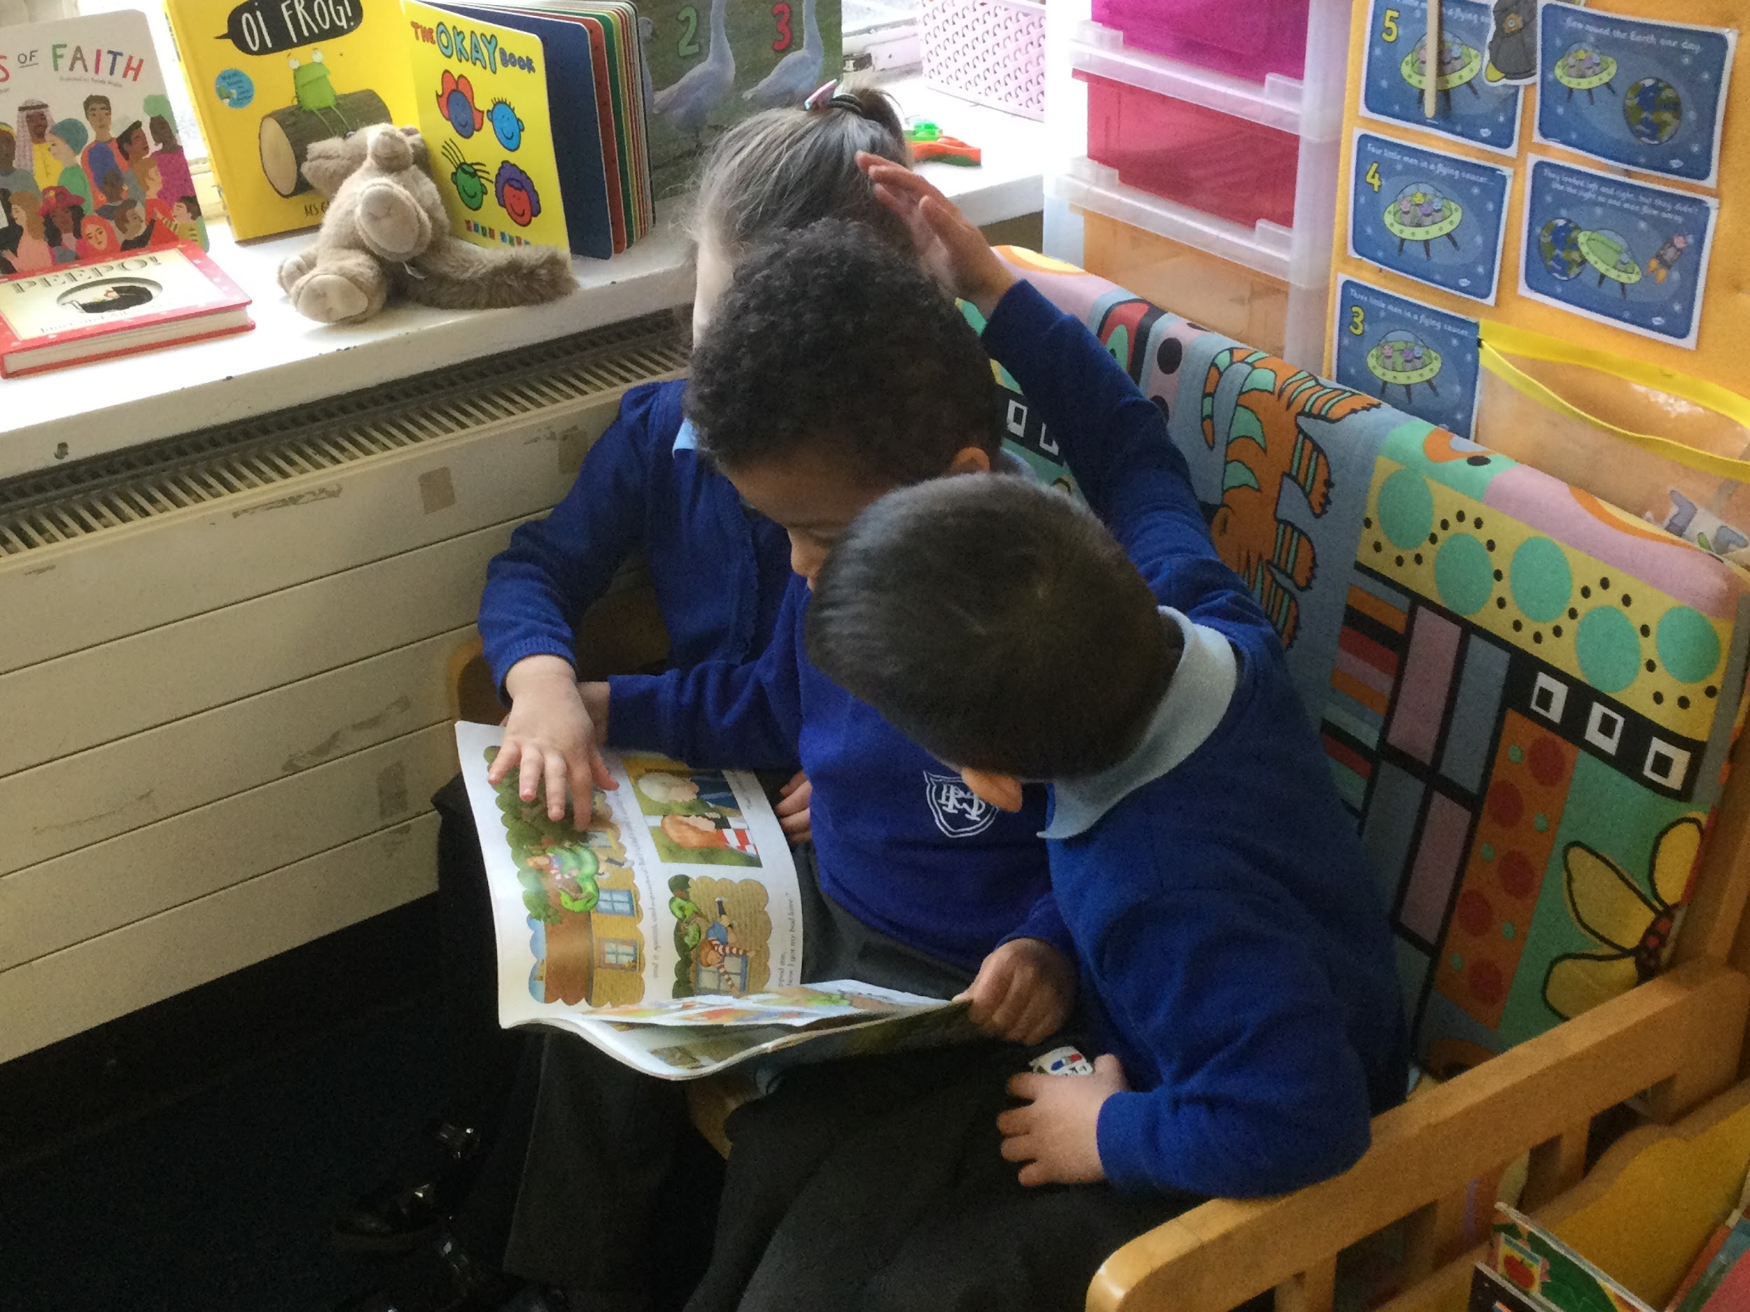

Slide 8
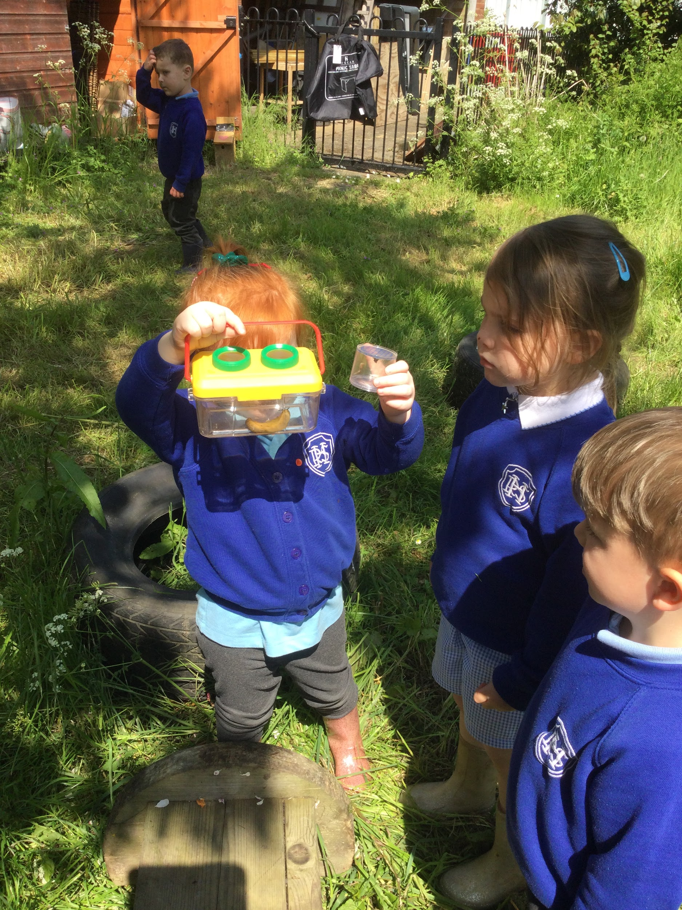
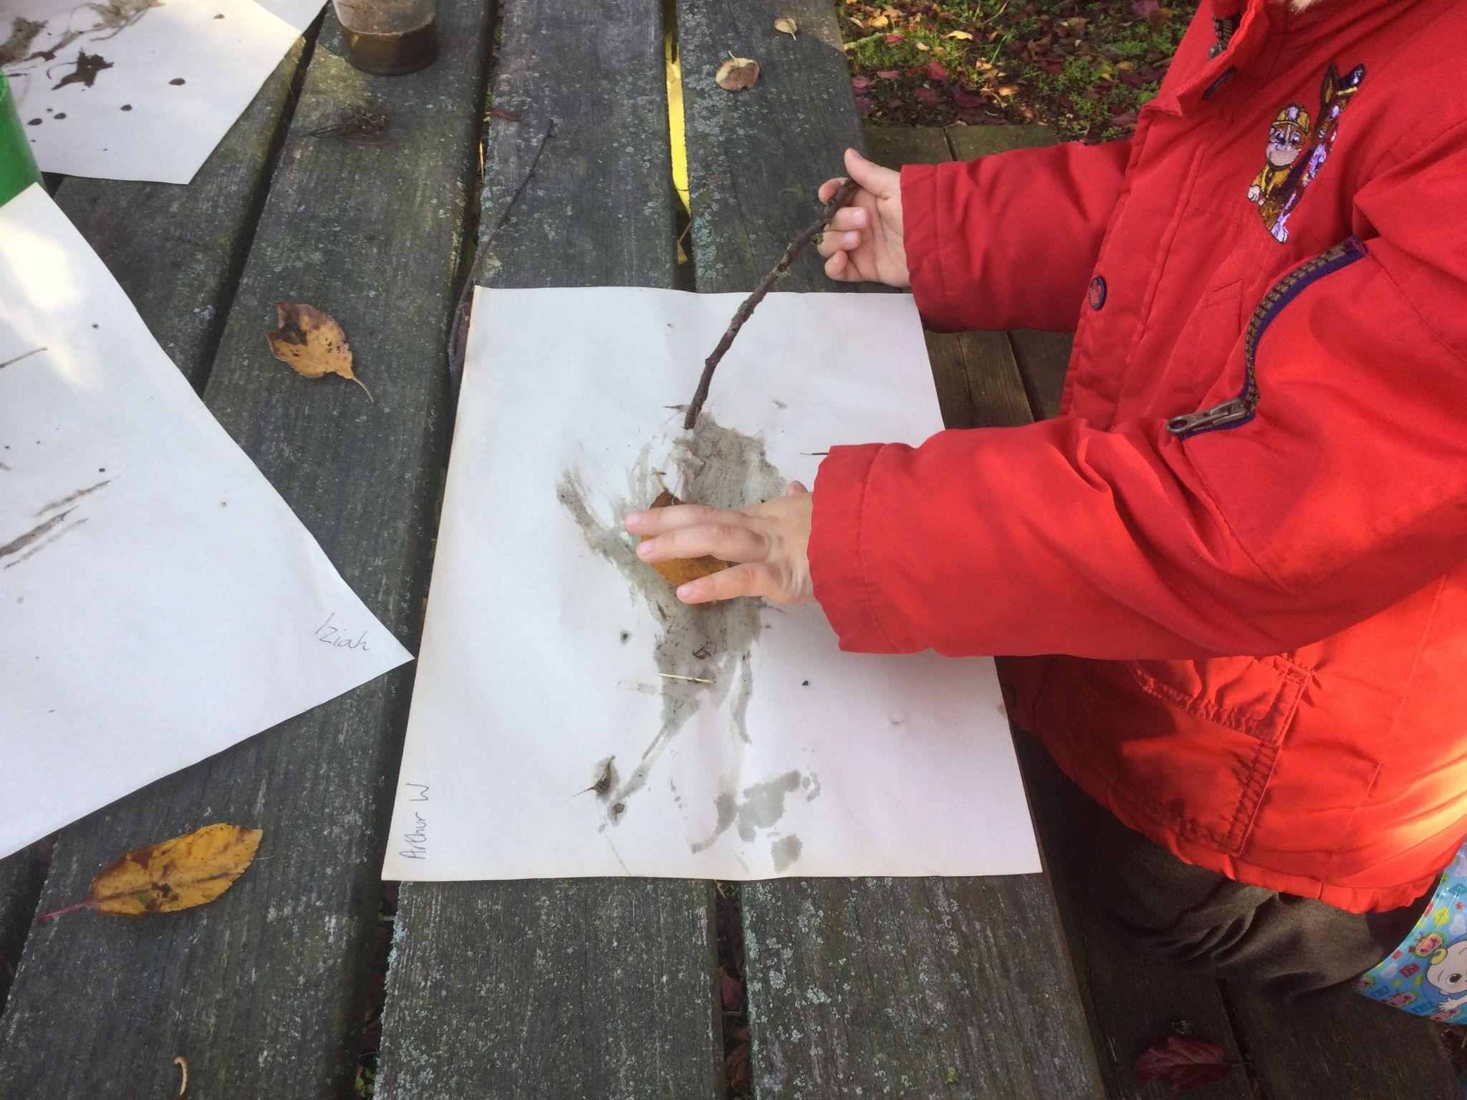
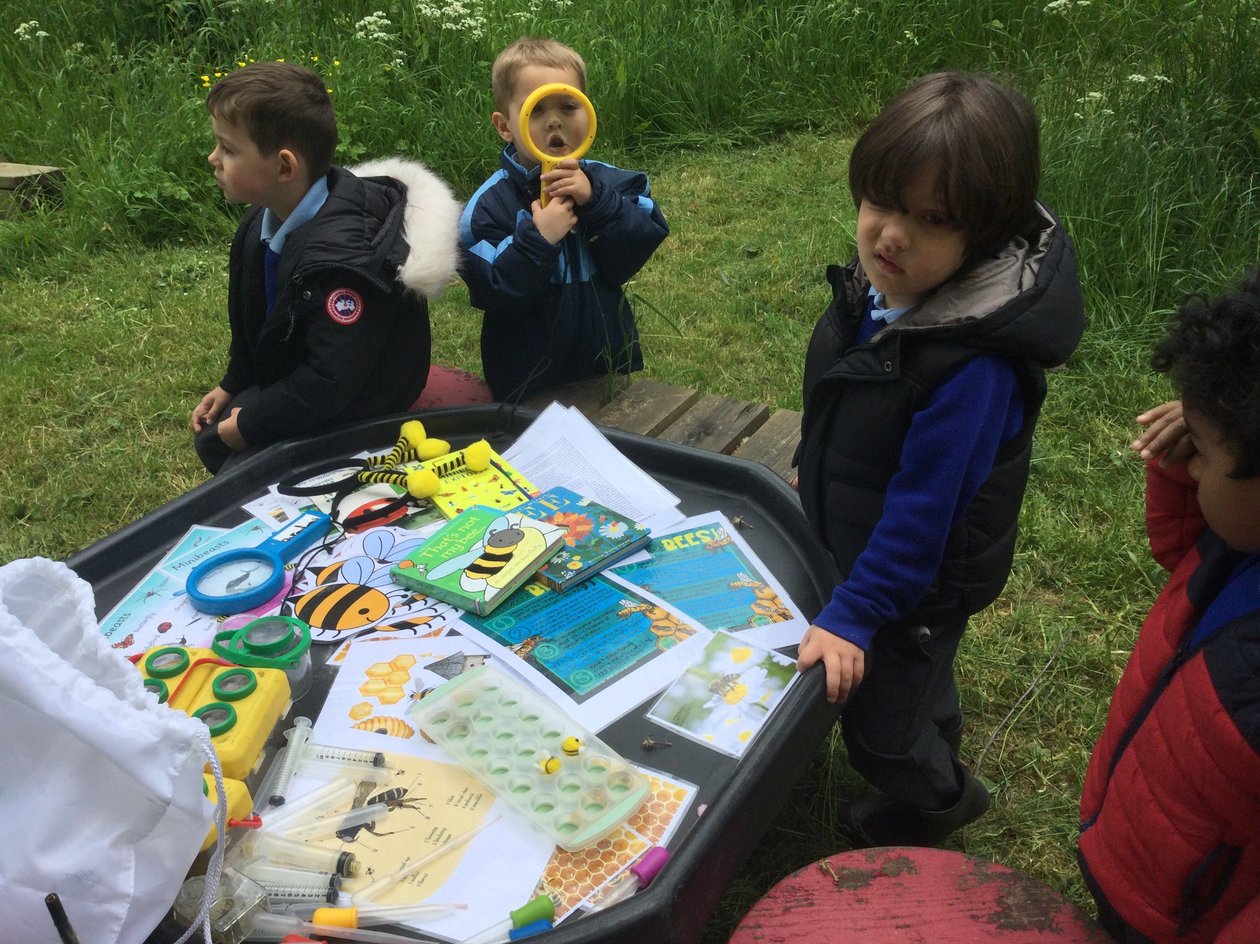
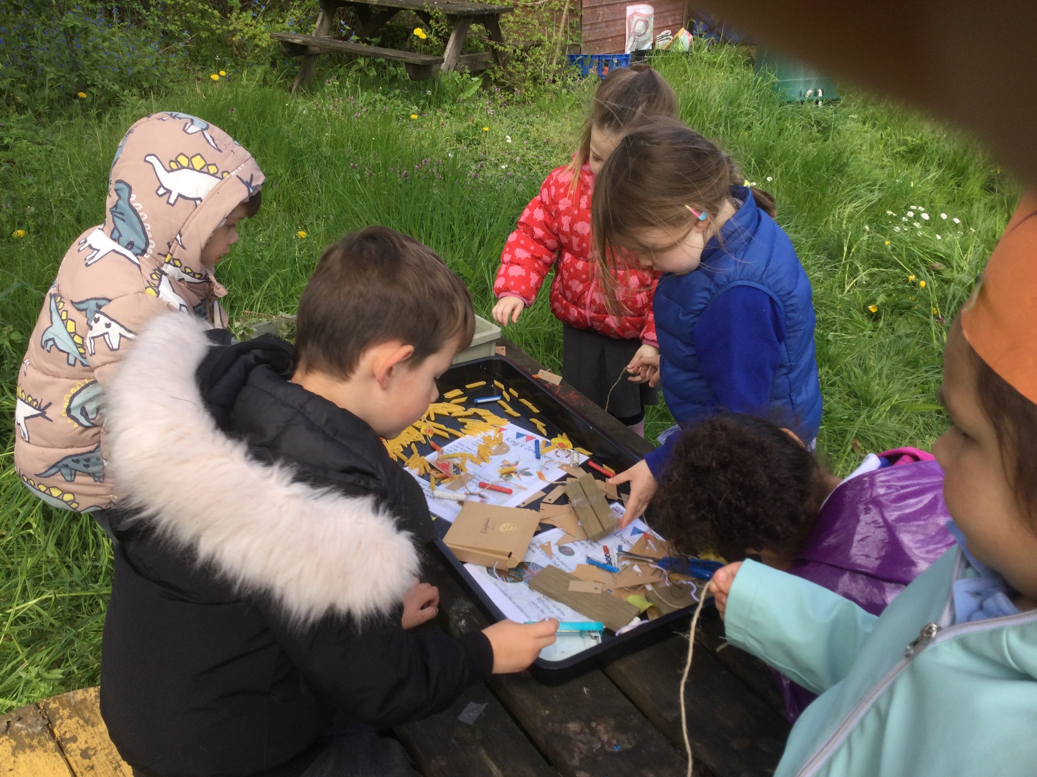
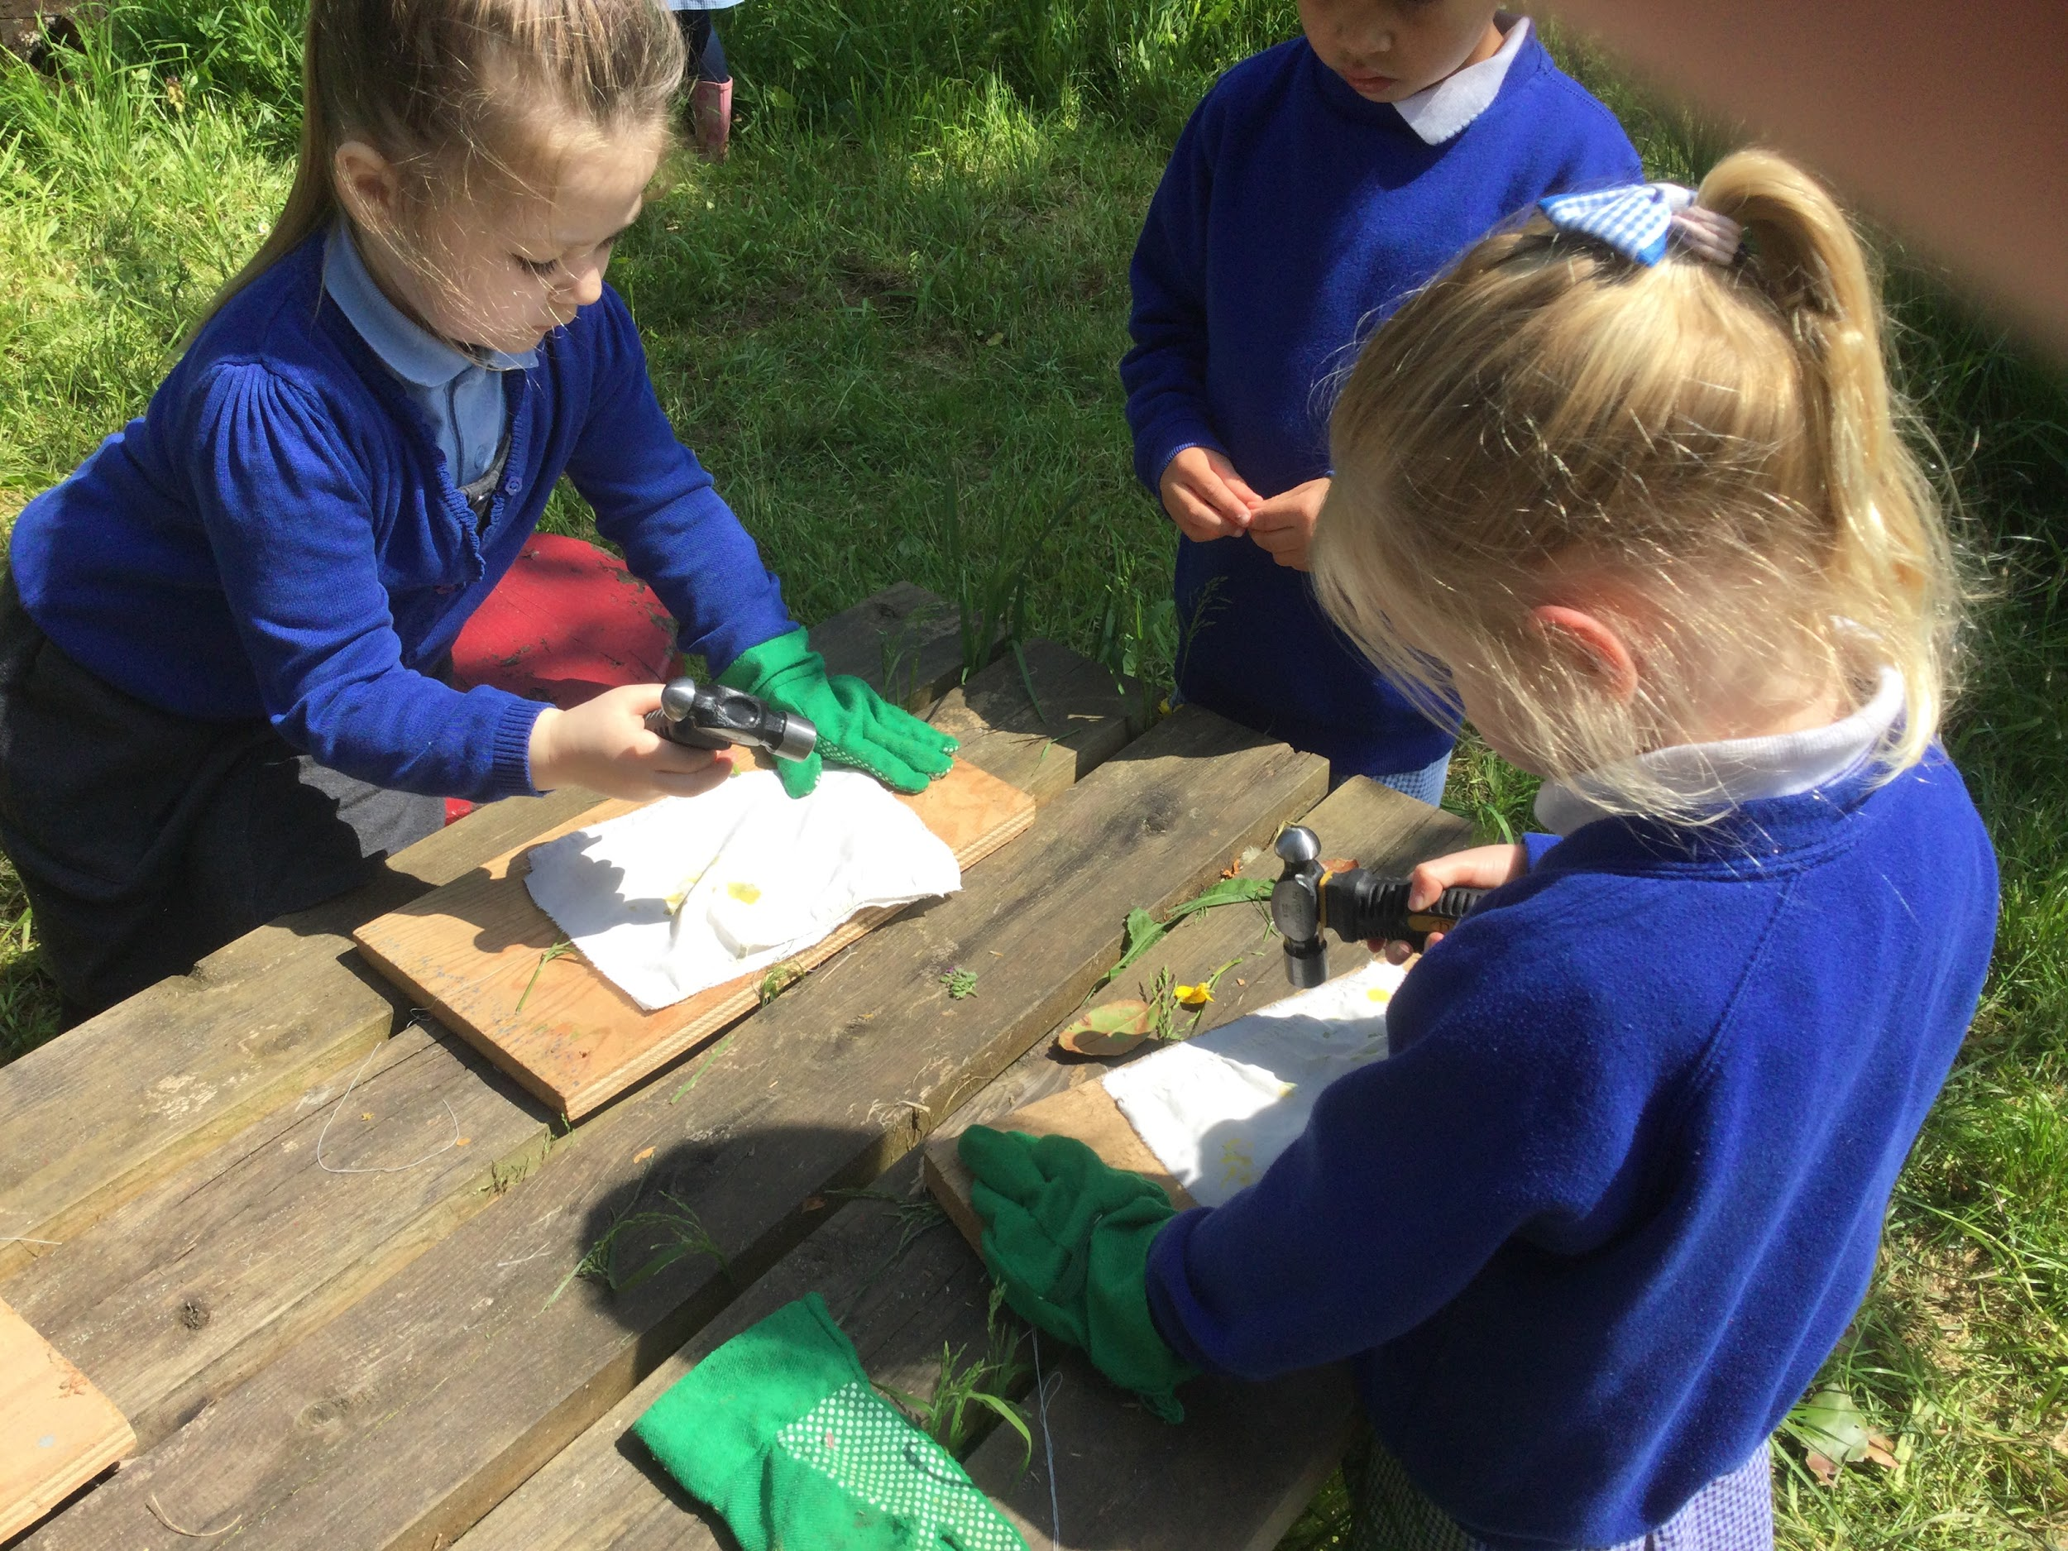
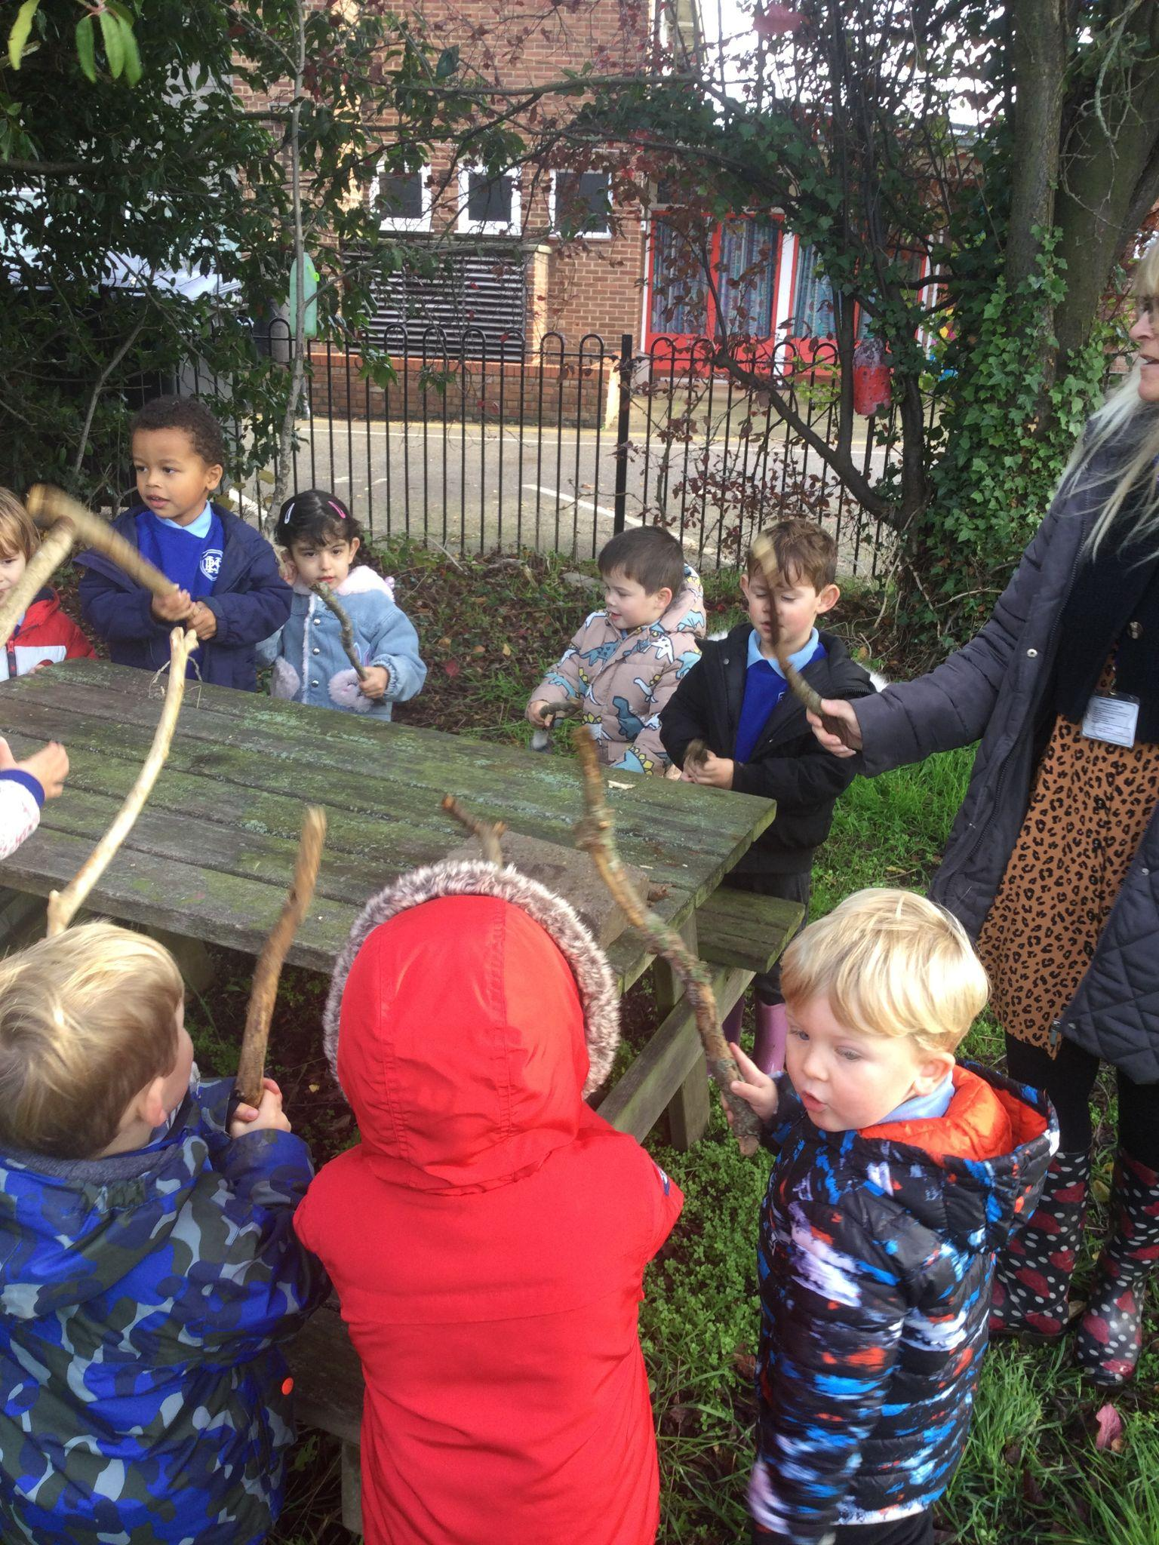
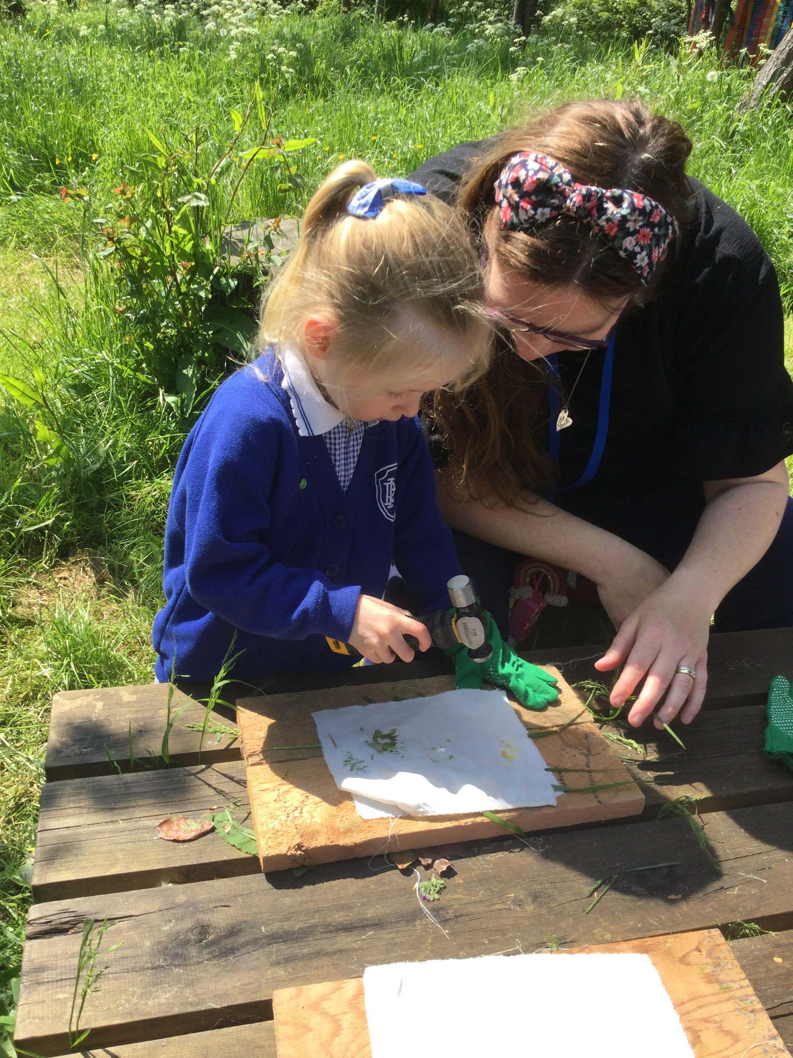
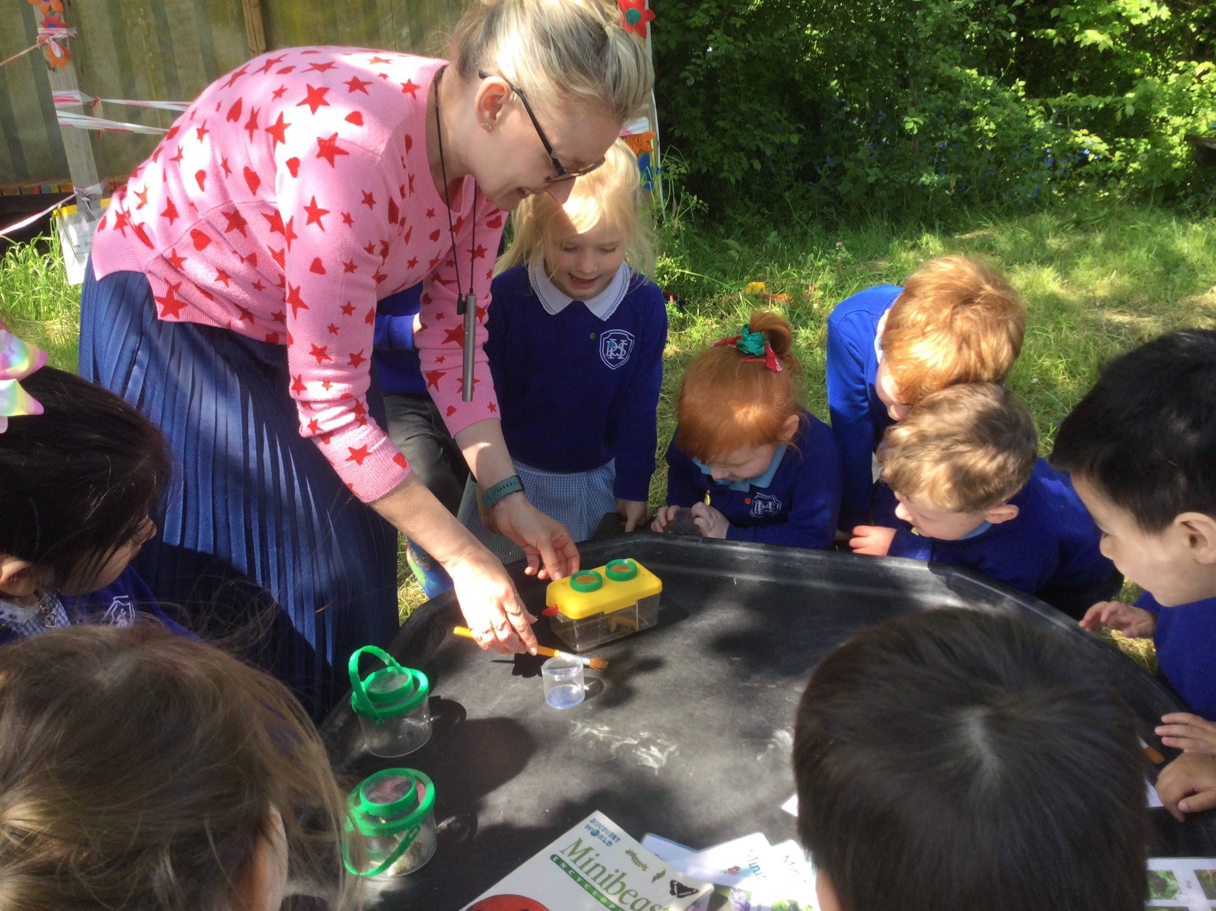
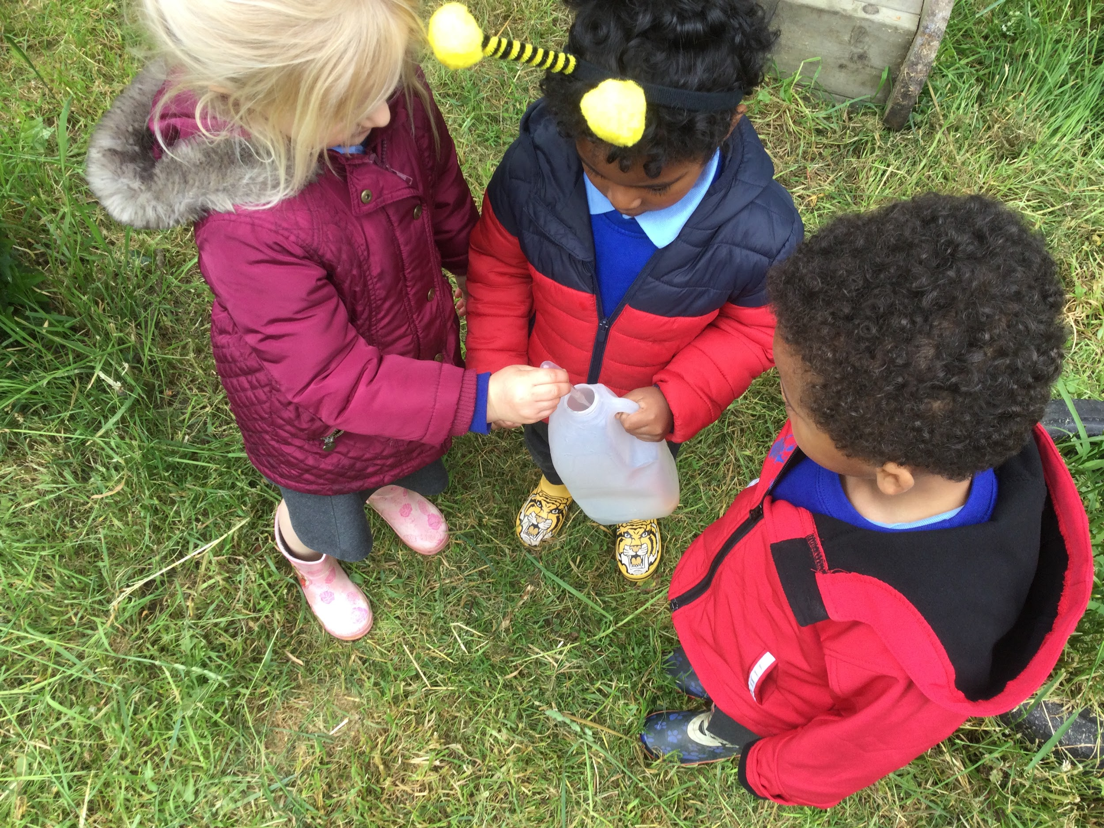
Secret garden

Slide 9
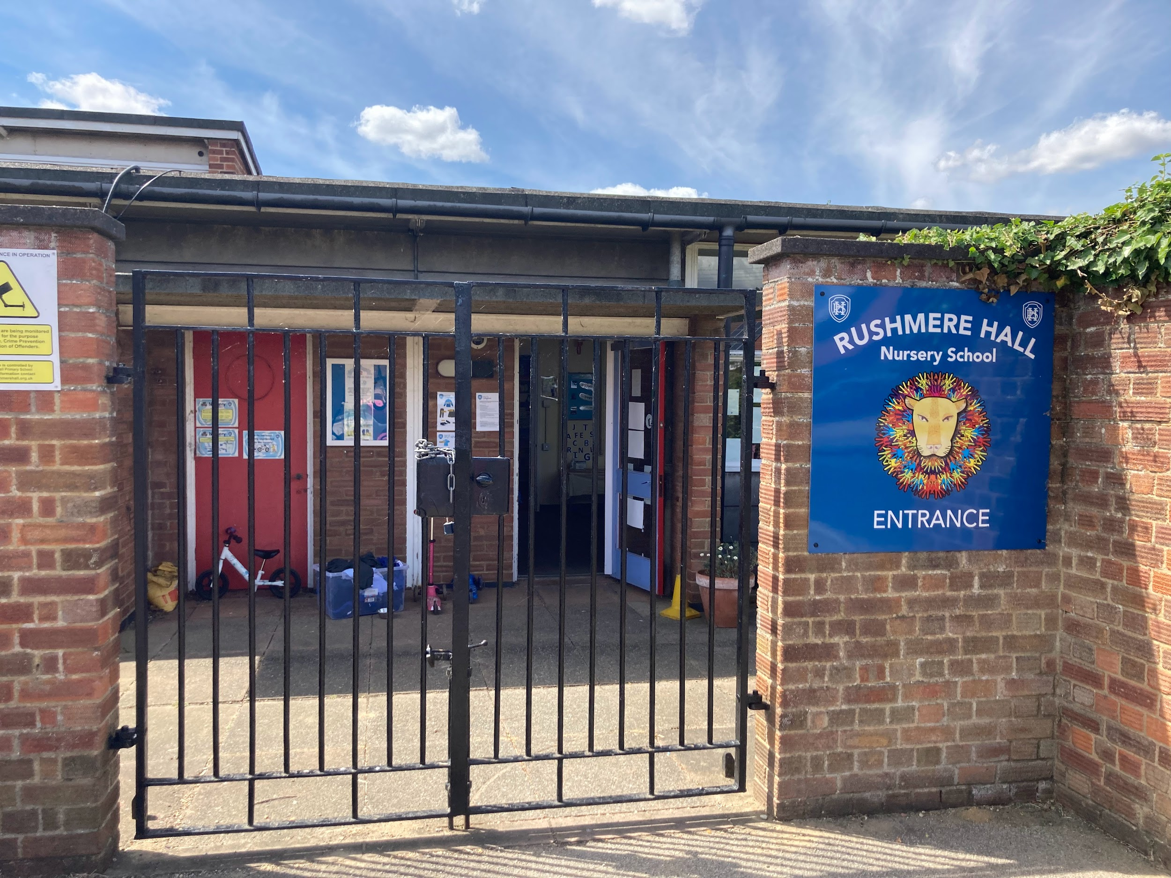
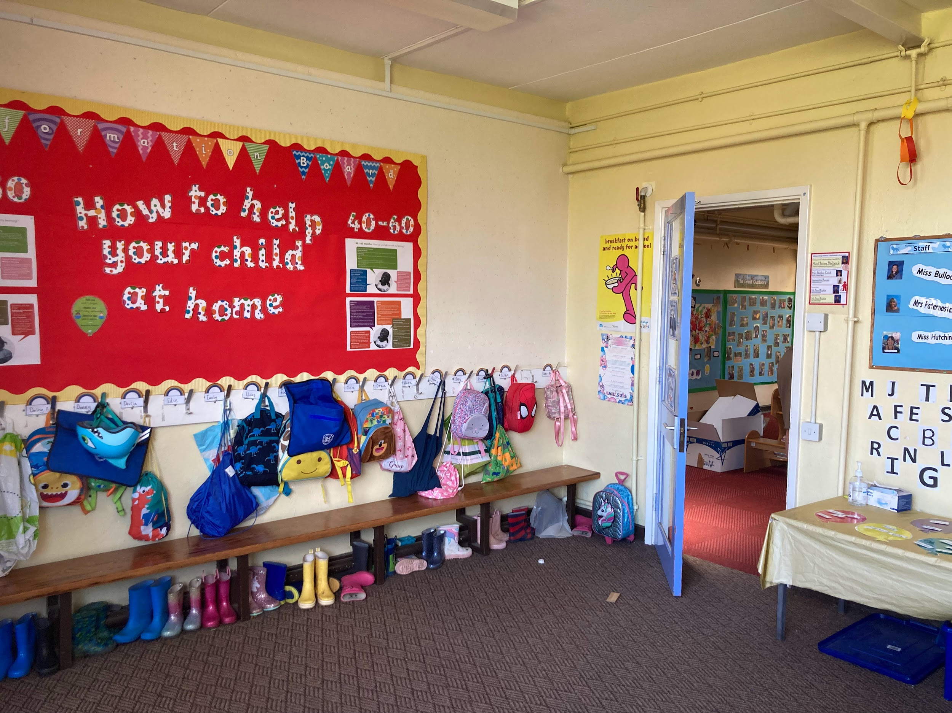
At this current time Nursery are unable to access our wrap around care i.e. breakfast and after school club.
Entrance Doors
Nursery begins: 8.45am – 9.00am
Home time:11:30-11:45am

Slide 10
At this current time Nursery are unable to access our wrap around care i.e. breakfast and after school club.
Entrance Doors
Nursery begins: 12.30 – 12.45pm
Home time:3:15-3:30pm

Slide 11
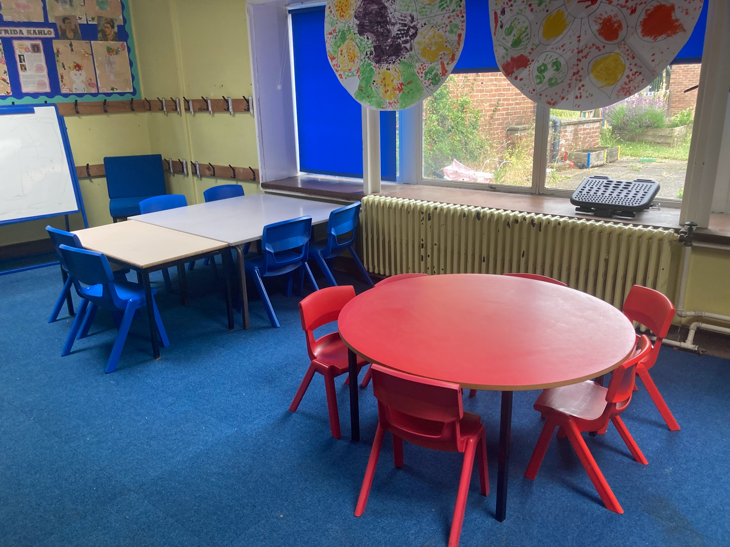
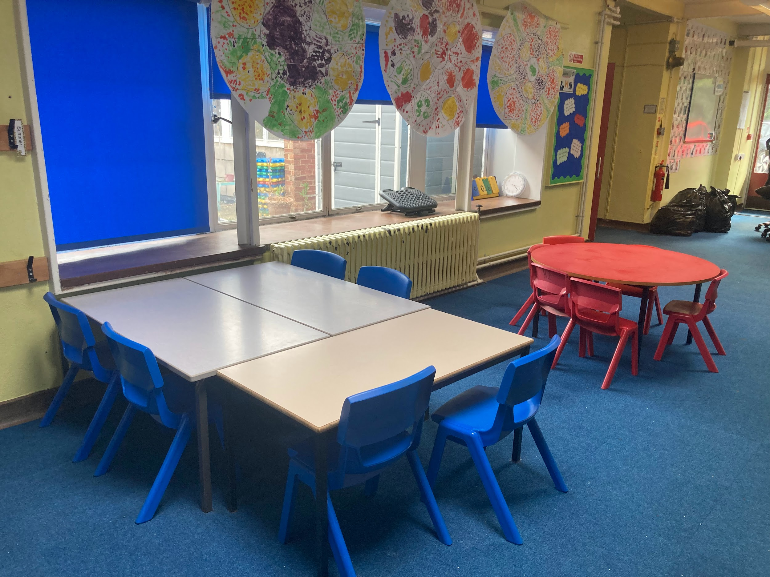
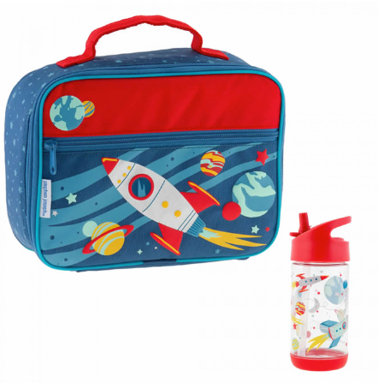
If your child is staying for lunch they will need to have a named lunchbox and named water bottle. There is a charge of £2.50 per session they stay.
Lunchtime

Slide 12
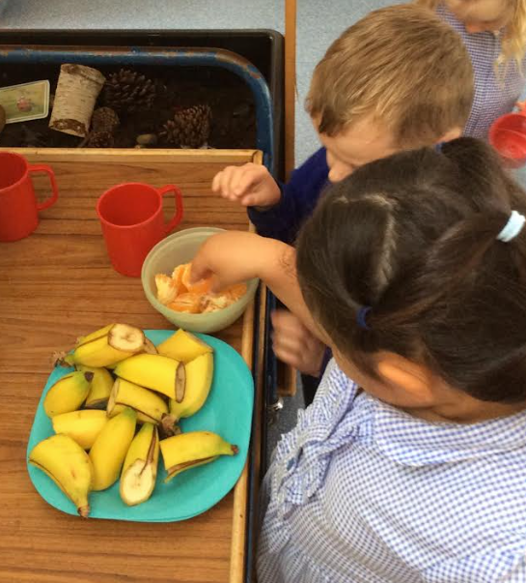
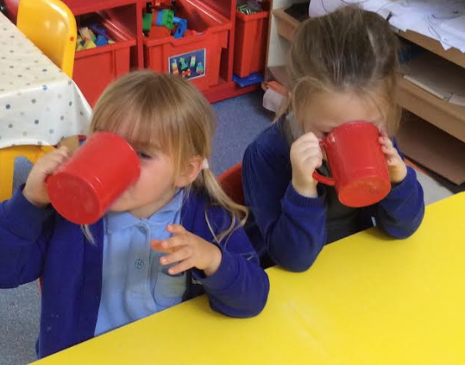
We have snack times mornings and afternoons. The children are given a choice of milk or water to drink, with a choice of fruit or vegetables. We ask for a contribution of £7.50 per term towards snack.
Snack time

Slide 13
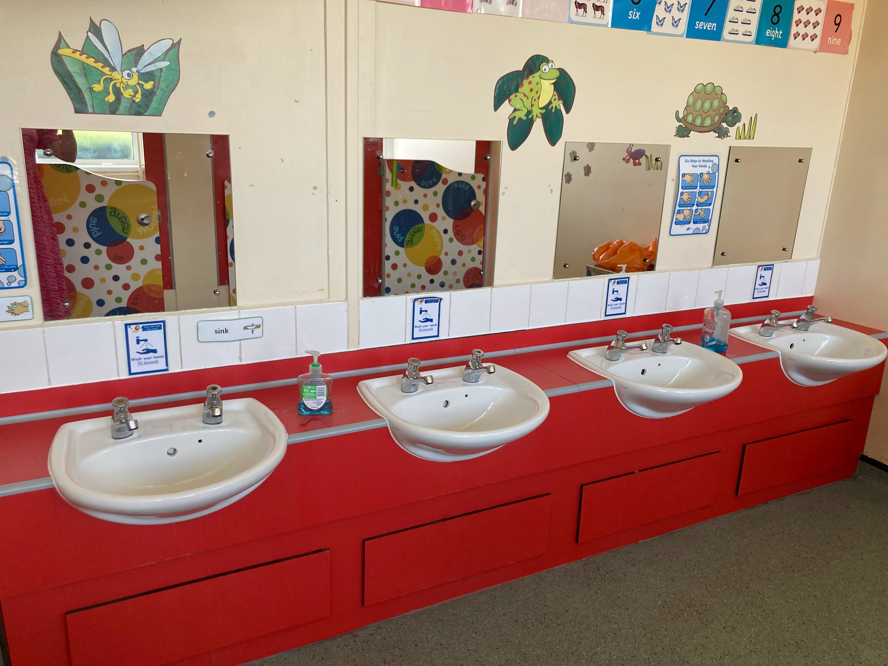
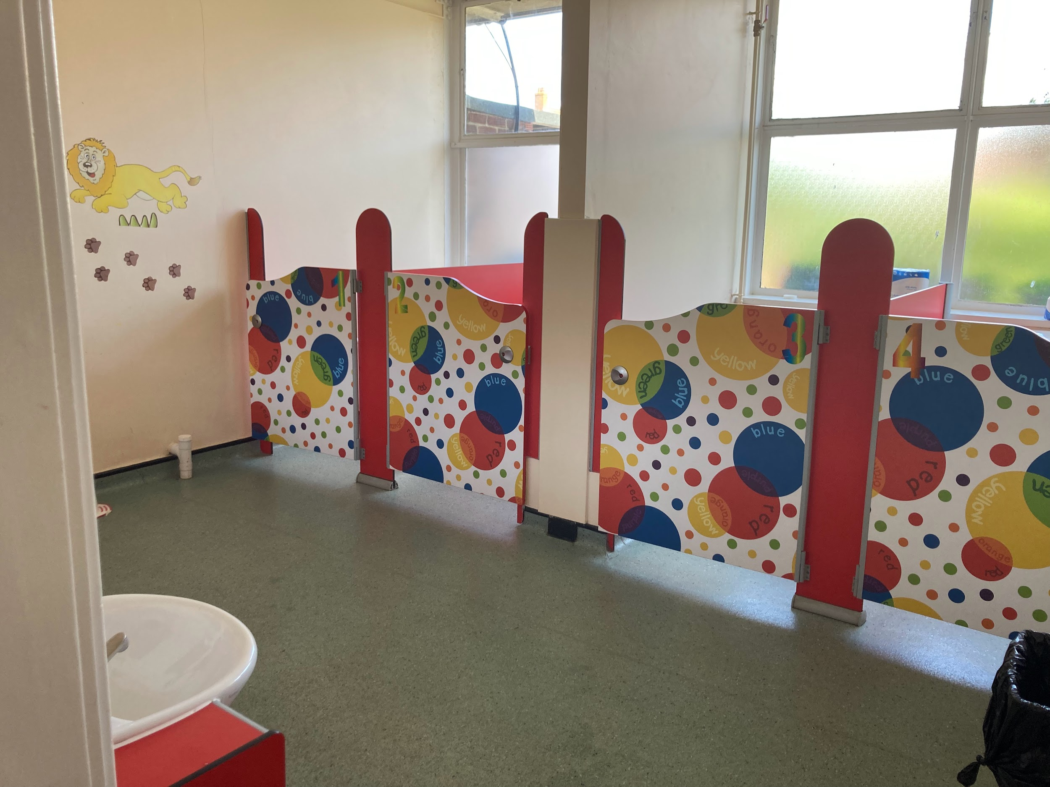
Nursery toilets are in the classroom making it easily accessible. Children are encouraged to use the toilets independently and have help as and when needed.
A change of clothes in a bag is important, accidents can happen when we are busy learners. Your child needs to be dry during the day to attend Nursery.
Nursery Toilets

Slide 14
Key Timetable Information
PE Days – Children will need a PE kit which can be kept in a bag on their peg. We change for PE as part of curriculum to become independent learners.
PE days are: Wednesday -AM
Friday - PM

Slide 15
Key Timetable Information
Secret Garden – Children will need a pair of wellies and if you happen to have a waterproof suit or waterproof trousers at home, these would be great to.
Secret Garden days are:
Tuesday -AM
Thursday - PM

Slide 16
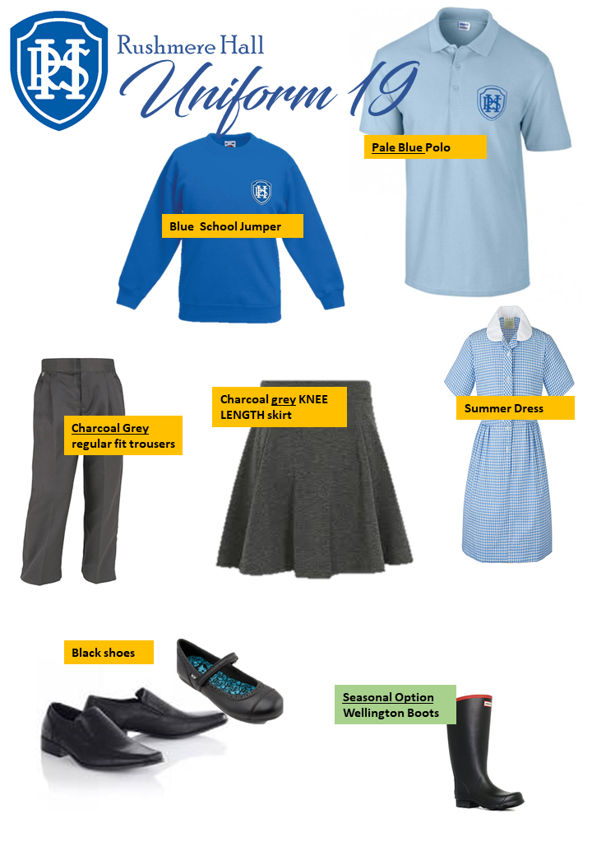
Uniform
Uniform can be ordered on line (via link on our website) or from the school uniform shop in town. PGM.
Please ensure your child arrives at school wearing correct uniform.

Slide 17
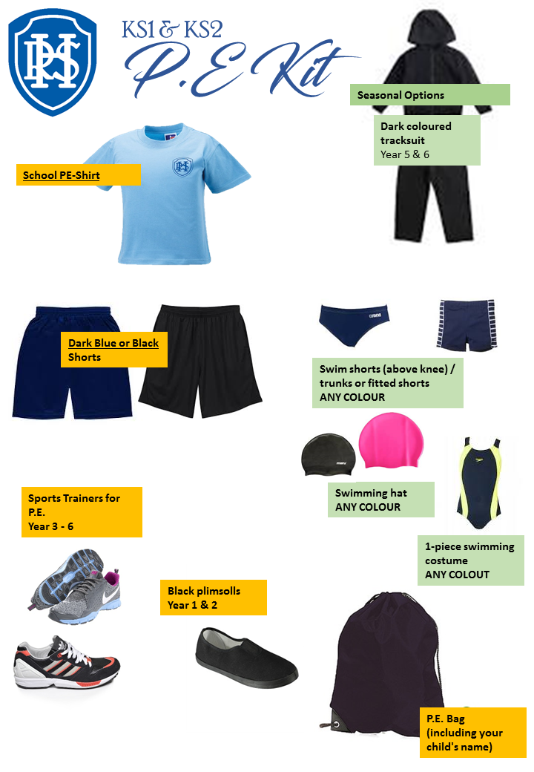
P.E. Kit
Children need to bring their PE kits to school. These can be left on their pegs.
I will send them home every half term for a freshen up.

Slide 18
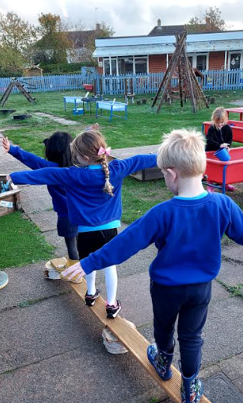
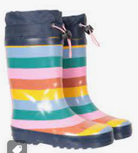
Key Timetable Information
Children need wellies in school everyday because we will be playing outside
Children need to bring a NAMED drink (plastic bottle) every day which they are encouraged to drink from regularly.
We spend a lot of time outdoors in Nursery and the doors are always open. Therefore please make sure your child wears warm clothes on colder days.
Please bring a spare set of clothes to be kept in school. Your child may need to change due to playing in the water or playing outside in damp weather!

Slide 19
Key Timetable Information
Library books will be changed every Monday and Friday. Children will be unable to change their library book until they have returned their previous one.
PLEASE BRING BOOK BAGS EVERY DAY

Slide 20
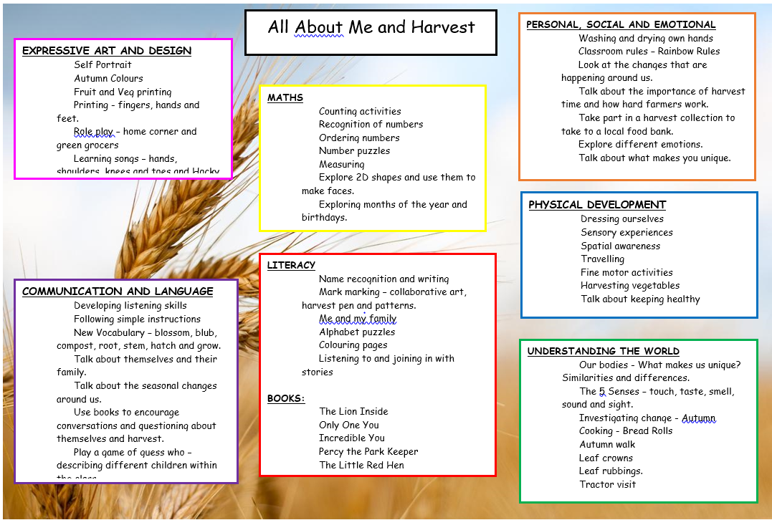
Autumn Curriculum Map
This what the classes are going to be learning during the Autumn term…
Paste in curriculum map

Slide 21
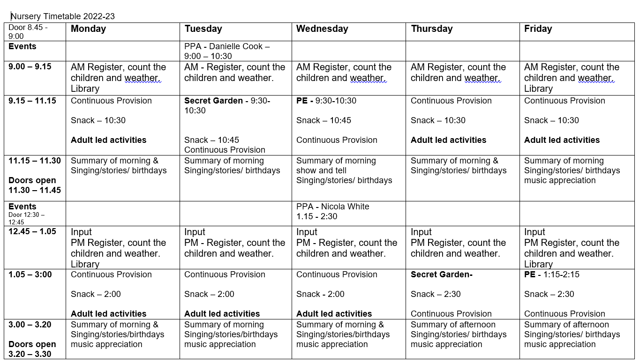
Key Timetable Information EXAMPLE

Slide 22
Play and stay sessions throughout the year.
Christmas sing along.
Sports Day.
Nursery Graduation.
Dates and times will be released in September.
Opportunities for parents/carers to
see their children in Nursery.

Slide 23
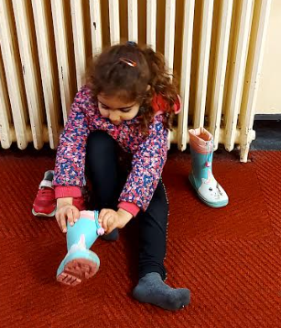
How to help prepare your child for Nursery…
Putting on their own coat and wellies/shoes.
Practising drinking from an open cup.

Slide 24
Communication
Come and talk to us!

Slide 25
We create a happy, safe and encouraging environment for your child. We believe happy children become confident learners.
Try not to worry!

